Slide 1
 | Van Dyck & Crowther, 2000 |  |  | Dickman et al., 1998 |  |  | Baker & Van Dyck, 2013 |  |  | Travouillon, 2016 |  |  | GMM
 | Raw | Size-free | Allometry-free | Raw | Size-free | Allometry-free | Raw | Size-free | Allometry-free | Raw | Size-free | Allometry-free | Raw | Size-free | Allometry-free
Correctness Rate | 0.904 | 0.875 | 0.846 | 0.904 | 0.853 | 0.757 | 0.875 | 0.86 | 0.757 | 0.882 | 0.853 | 0.684 | 0.926 | 0.86 | 0.581
Accuracy | 0.759 | 0.686 | 0.553 | 0.779 | 0.681 | 0.517 | 0.741 | 0.687 | 0.503 | 0.764 | 0.712 | 0.335 | 0.843 | 0.761 | 0.286
Ability to Separate | 0.855 | 0.763 | 0.655 | 0.87 | 0.784 | 0.706 | 0.837 | 0.793 | 0.666 | 0.879 | 0.858 | 0.605 | 0.943 | 0.983 | 0.879
Confidence | 0.915 | 861 | 0.791 | 0.924 | 0.874 | 0.817 | 0.905 | 0.879 | 0.794 | 0.927 | 0.914 | 0.754 | 0.967 | 0.99 | 0.928
Confidence for each true class | North: 0.89 | North: 0.773 | North: 0.72 | North: 0.889 | North: 0.802 | North: 0.794 | North: 0.86 | North: 0.776 | North: 0.724 | North: 0.892 | North: 0.863 | North: 0.81 | North: 0.963 | North: 0.961 | North: 0.947
 | South: 0.875 | South: 0.807 | South: 0.786 | South: 0.886 | South: 0.817 | South: 0.833 | South: 0.87 | South: 0.819 | South: 0.781 | South: 0.926 | South: 0.897 | South: 0.757 | South: 0.953 | South: 0.997 | South: 0.944
 | Sub: 0.949 | Sub: 0.931 | Sub: 0.824 | Sub: 0.961 | Sub: 0.937 | Sub: 0.818 | Sub: 0.945 | Sub: 0.958 | Sub: 0.832 | Sub: 0.944 | Sub: 0.946 | Sub: 0.728 | Sub: 0.976 | Sub: 0.998 | Sub: 0.91
Allometry | R² = 0.078, F = 11.328, p = 0.001 |  |  | R² = 0.143, F = 22.347, p = 0.001 |  |  | R² = 0.112, F = 16.886, p = 0.001 |  |  | R² = 0.252, F = 45.038, p = 0.001 |  |  | R² = 0.132, F = 20.403, p = 0.001
Notes:
Table 2. this time with 95% PC scores variance for the LMM data, it performs a little bit worse.

Slide 2
 | Van Dyck & Crowther, 2000 |  |  | Dickman et al., 1998 |  |  | Baker & Van Dyck, 2013 |  |  | Travouillon, 2016 |  |  | GMM
 | Raw | Size-free | Allometry-free | Raw | Size-free | Allometry-free | Raw | Size-free | Allometry-free | Raw | Size-free | Allometry-free | Raw | Size-free | Allometry-free
Correctness Rate | 0.89 | 0.882 | 0.838 | 0.868 | 0.89 | 0.757 | 0.897 | 0.89 | 0.794 | 0.875 | 0.868 | 0.684 | 0.926 | 0.86 | 0.581
Accuracy | 0.791 | 0.766 | 0.667 | 0.774 | 0.772 | 0.578 | 0.793 | 0.778 | 0.601 | 0.767 | 0.773 | 0.343 | 0.843 | 0.761 | 0.286
Ability to Separate | 0.914 | 0.891 | 0.823 | 0.9 | 0.889 | 0.804 | 0.91 | 0.911 | 0.817 | 0.906 | 0.903 | 0.634 | 0.943 | 0.983 | 0.879
Confidence | 0.949 | 0.936 | 0.893 | 0.941 | 0.934 | 0.879 | 0.947 | 0.947 | 0.888 | 0.944 | 0.941 | 0.775 | 0.967 | 0.99 | 0.928
Confidence for each true class | North: 0.94 | North: 0.922 | North: 0.877 | North: 0.888 | North: 0.885 | North: 0.861 | North: 0.92 | North: 0.916 | North: 0.881 | North: 0.917 | North: 0.917 | North: 0.831 | North: 0.963 | North: 0.961 | North: 0.947
 | South: 0.931 | South: 0.935 | South: 0.916 | South: 0.932 | South: 0.932 | South: 0.9 | South: 0.942 | South: 0.941 | South: 0.91 | South: 0.928 | South: 0.915 | South: 0.778 | South: 0.953 | South: 0.997 | South: 0.944
 | Sub: 0.963 | Sub: 0.943 | Sub: 0.888 | Sub: 0.968 | Sub: 0.957 | Sub: 0.876 | Sub: 0.961 | Sub: 0.964 | Sub: 0.879 | Sub: 0.965 | Sub: 0.967 | Sub: 0.749 | Sub: 0.976 | Sub: 0.998 | Sub: 0.91
Allometry | R² = 0.079, F = 11.475, p = 0.001 |  |  | R² = 0.144, F = 22.48, p = 0.001 |  |  | R² = 0.113, F = 17.064, p = 0.001 |  |  | R² = 0.251, F = 44.99, p = 0.001 |  |  | R² = 0.132, F = 20.403, p = 0.001
Supp table with all LMM data instead of PC 95% variance, need to correct

Slide 3
 | Van Dyck & Crowther, 2000 | Dickman et al., 1998 | Baker & Van Dyck, 2013 | Travouillon, 2016
Van Dyck & Crowther, 2000 |  | 61.9 % | 66.67 % | 27.27 %
Dickman et al., 1998 | 100 % |  | 72.22 % | 40.91 %
Baker & Van Dyck, 2013 | 92.31 % | 61.9 % |  | 31.82 %
Travouillon, 2016 | 46.15 % | 42.86 % | 33.33 %

Slide 4
Van Dyck & Crowther, 2000 | Dickman et al., 1998 | Baker & Van Dyck, 2013 | Travouillon, 2016 | Landmark distances
BL | CON | BL |  | 6 to 10
PL | PAL | PL |  | 7 to 10
P1-3 | P1-3 | UPL | UPR | 25 to 27 (26 to 28)
SWR-LC1A | SWC | R-LC1 | RWC | 25 to 26
C1M4 | C1M4 |  | CTL | 25 to 37 (26 to 38)
IPVL | IPD | IPV |  | 77 to 79 (78 to 80)
SWR-LM3 | SWM3 | R-LM3 |  | 41 to 42
TC | TCD | TC |  | 67 to 68 (69 to 70)
IBW | IBW | IBW |  | 65 to 66
OBW | OBM | OBW |  | 45 to 46
APVL | APV | APV | APL | 79 to 81 (80 to 82)
PPVL | PPV | PPV | PPL | 75 to 77 (76 to 78)
M1-4 | M1-4 | UML | UMR | 27 to 37 (28 to 38)
 | AW |  |  | 71 to 72
 | PNS |  | NPS | 11 to 17 (12 to 18)
 | NWI |  | ANW | 11 to 12
 | NL |  |  | 1 to 2
 | NOW | NWR | PNW | 19 to 20
 | GL |  |  | 4 to 10
 | FMH |  |  | 5 to 6
 | FMW |  |  | 55 to 56
 |  | HT-B |  | squareroot of (3 to 69 or 70)squared - ((69 to 70)/2)squared
 |  | PML |  | squareroot of (10 to 17 or 18)squared - ((17 to 18)/2)squared
 |  | I1-P3 |  | 10 to 27 or 28
 |  | NW |  | 17 to 18
 |  | R-LM1T | OP3 | 27 to 28
 |  |  | ONL | 1 to 4
 |  |  | NL | 2 to 10
 |  |  | RWI | 29 to 31 (30 to 32)
 |  |  | FS | 2 to 3
 |  |  | PPW | 23 to 24
 |  |  | BCL | 10 to 5
 |  |  | IL | 10 to 15 or 16
 |  |  | APW | 79 to 80 (81 to 82)
 |  |  | BOL | 61 to 65 (62 to 66)
 |  |  | MW | 47 to 49
 |  |  | POW | 59 to 60
 |  |  | CW | 57 to 58

Slide 6
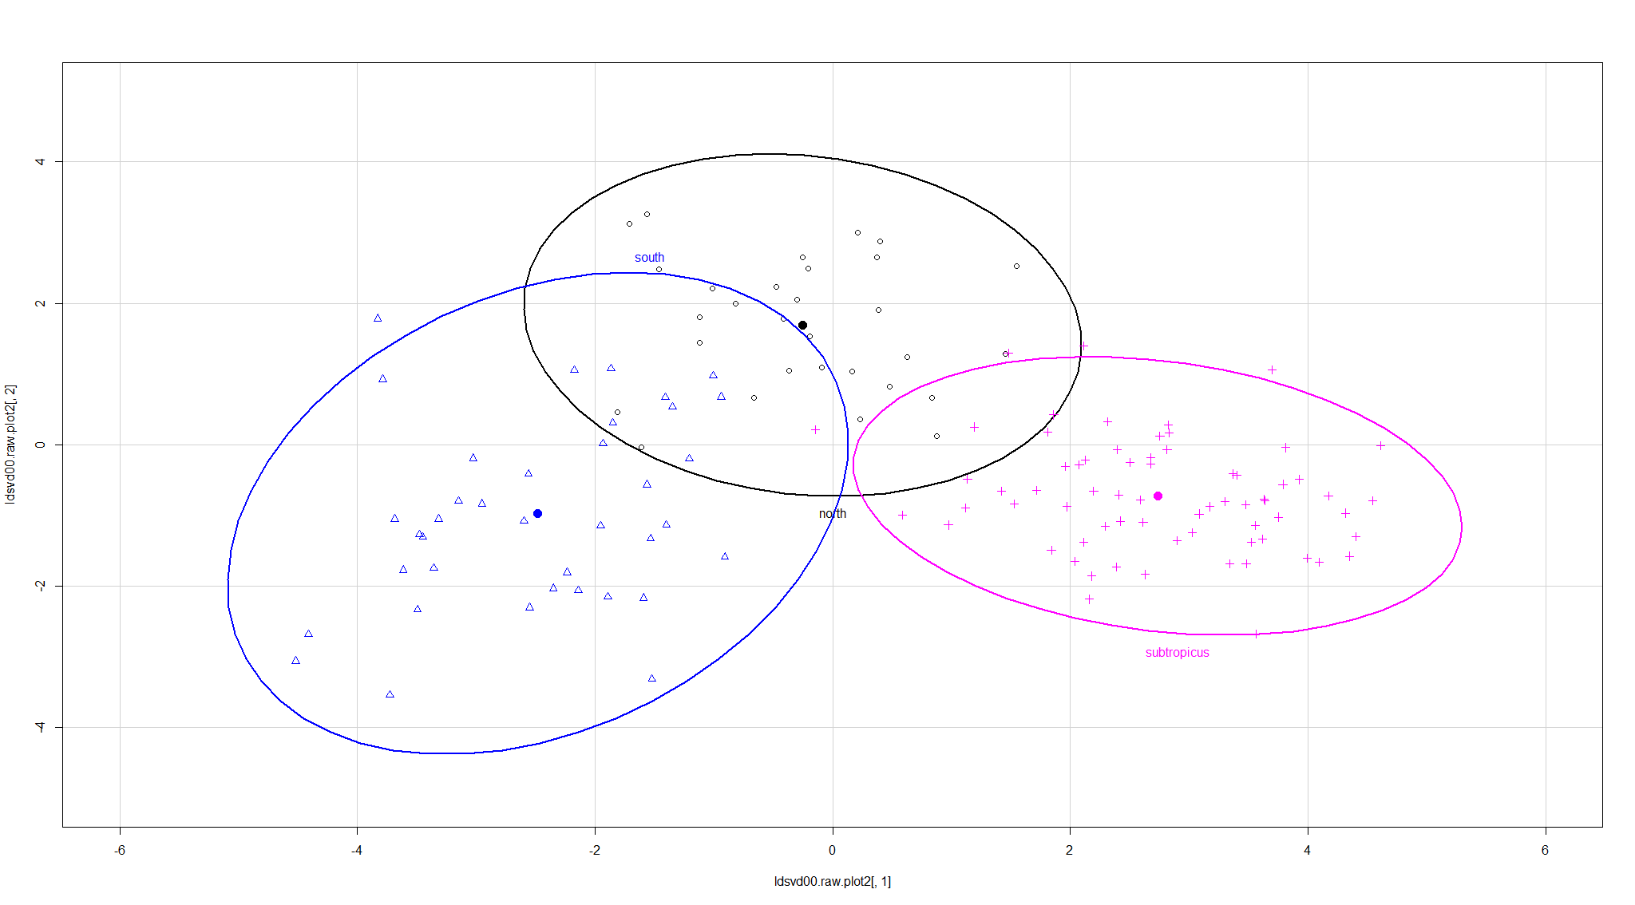

Slide 7
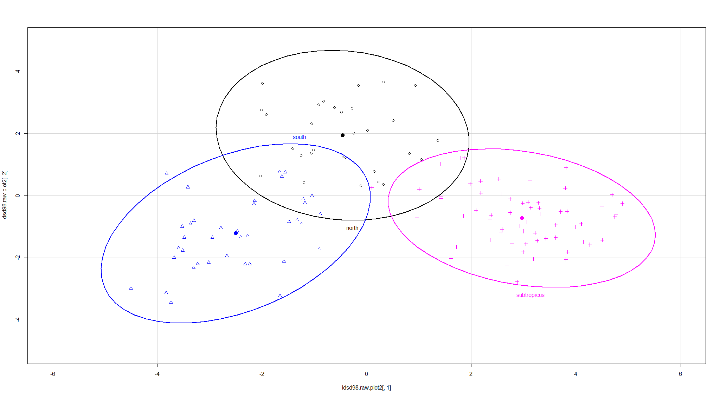

Slide 8
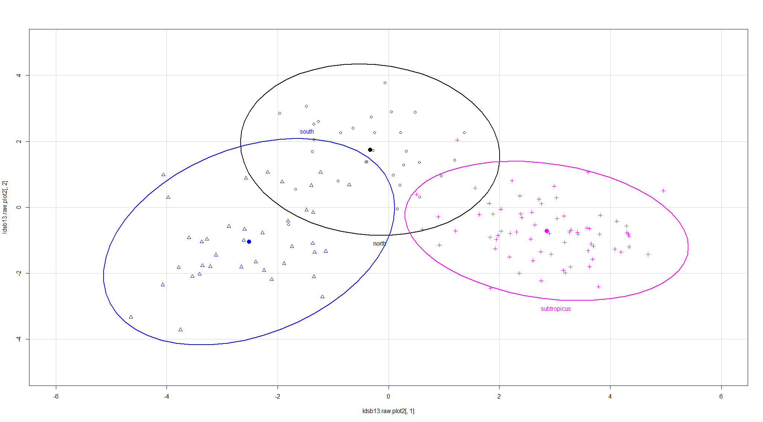

Slide 9
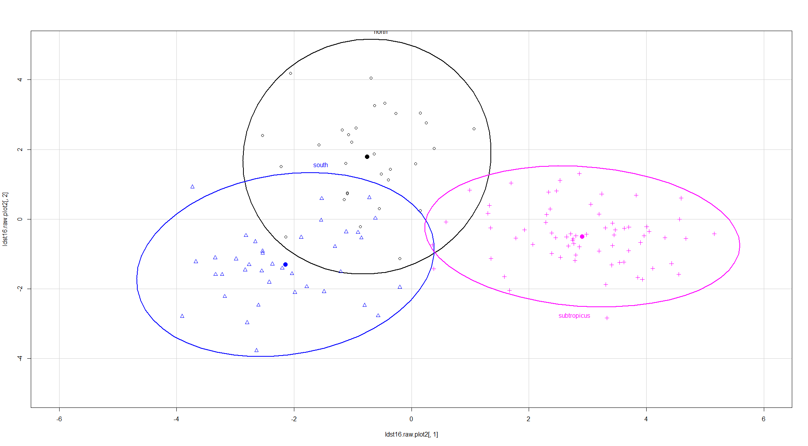

Slide 10
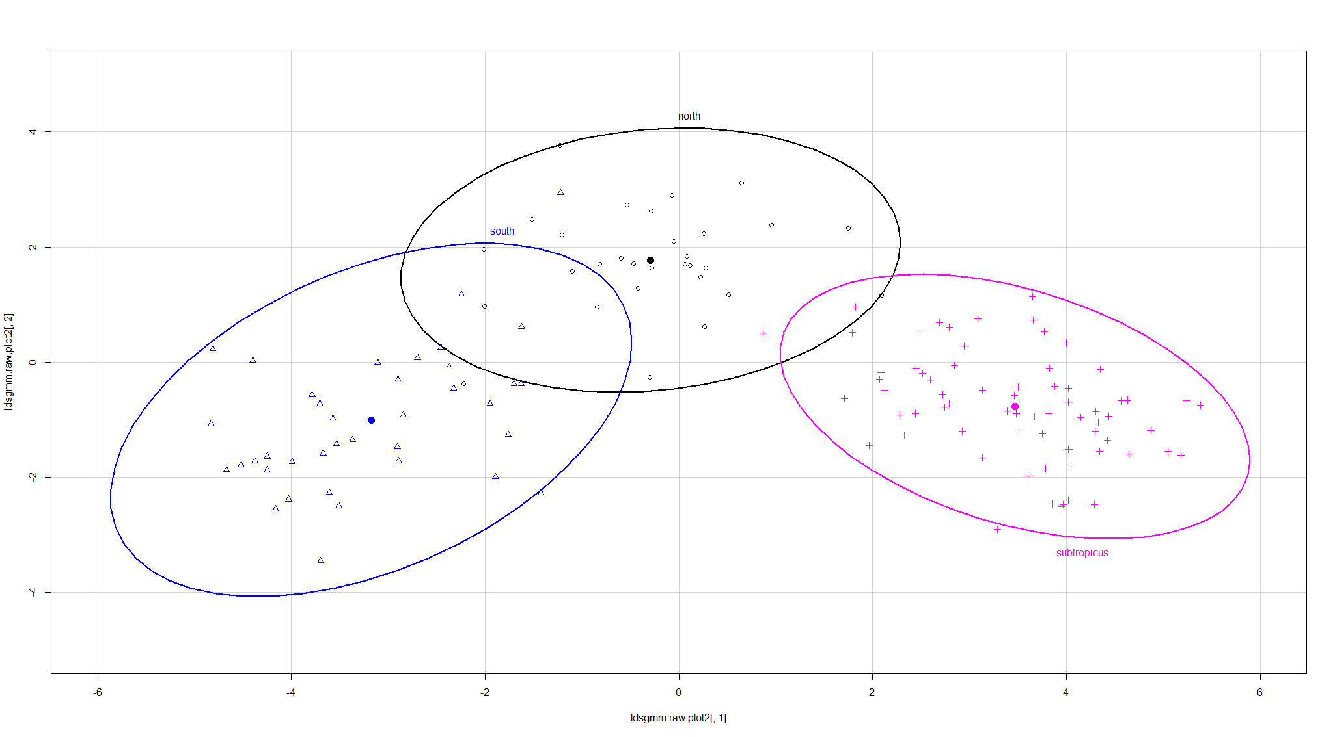

Slide 11
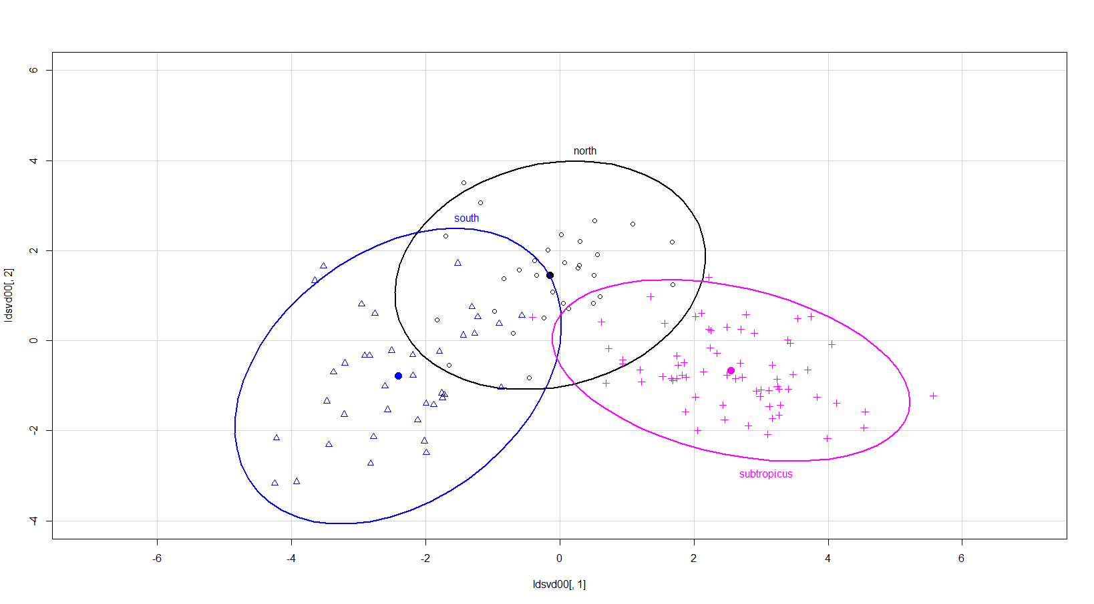

Slide 12
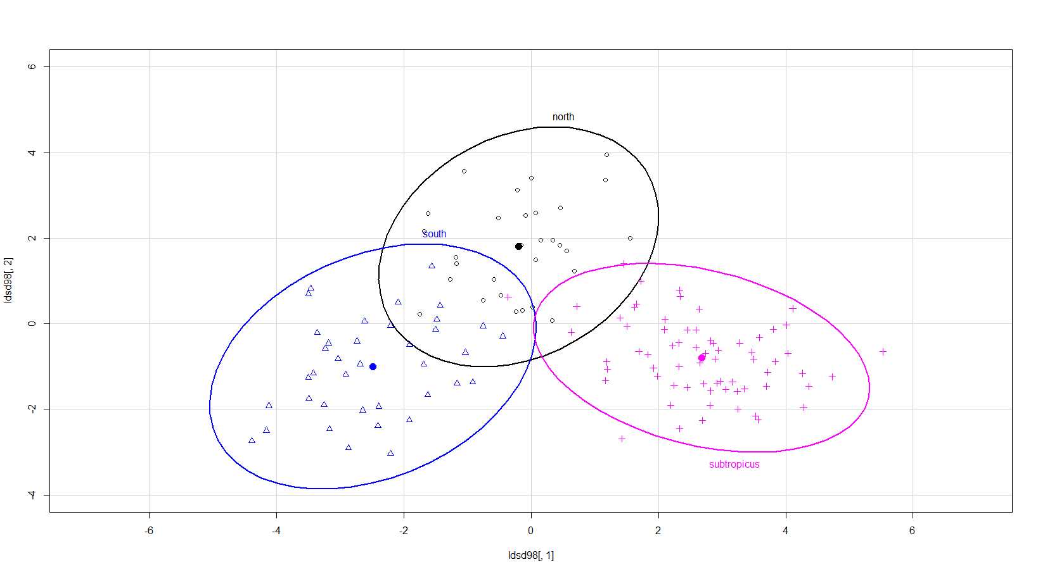

Slide 14
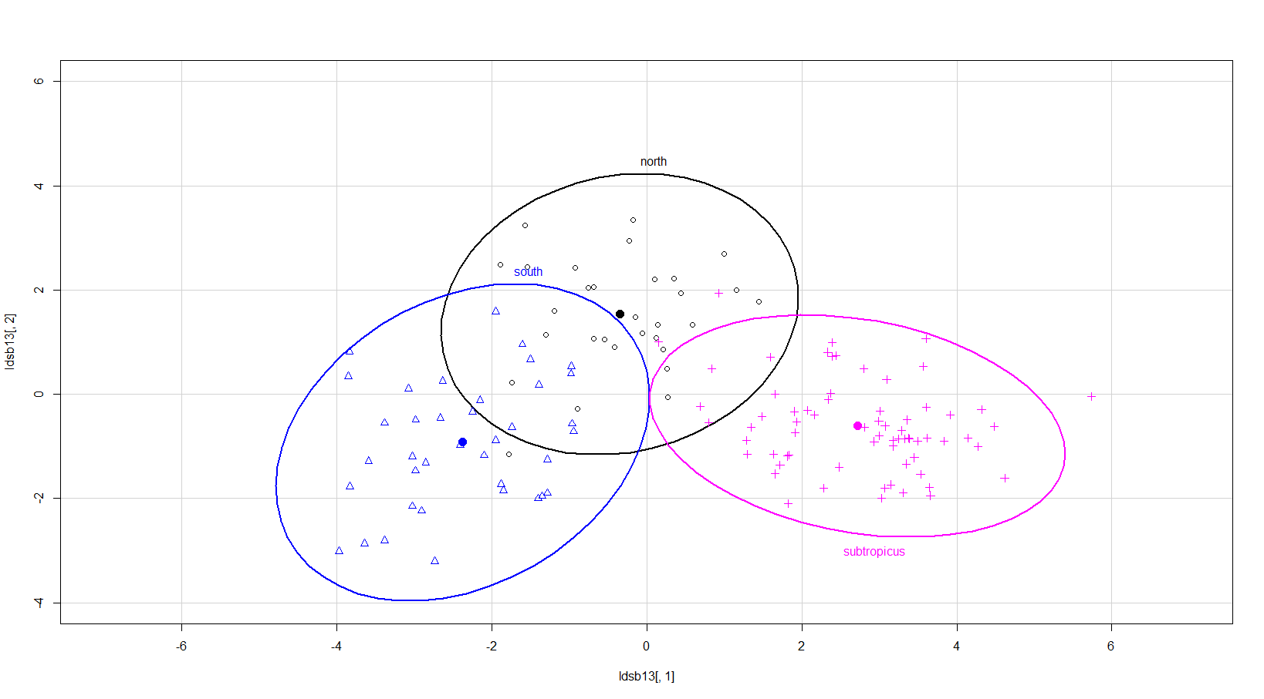

Slide 15
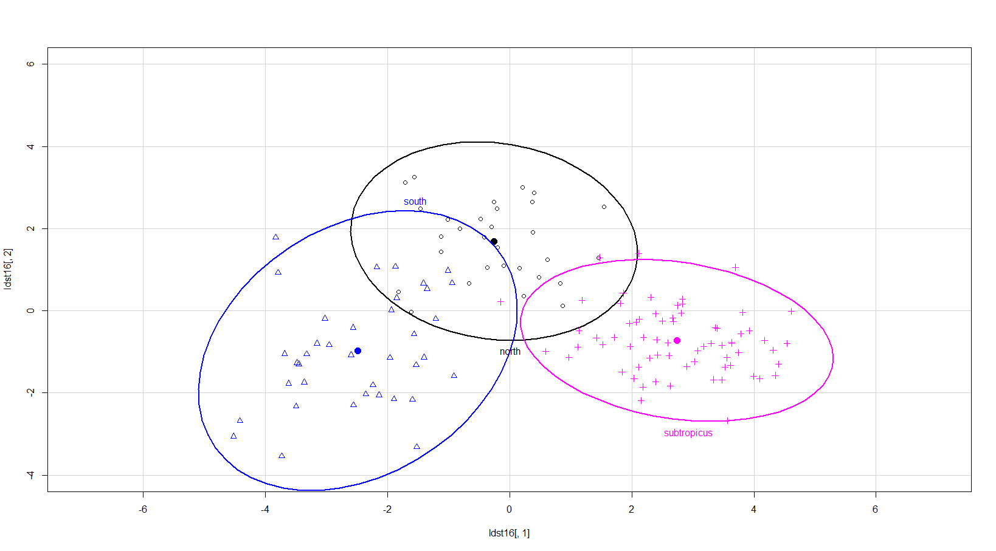

Slide 16
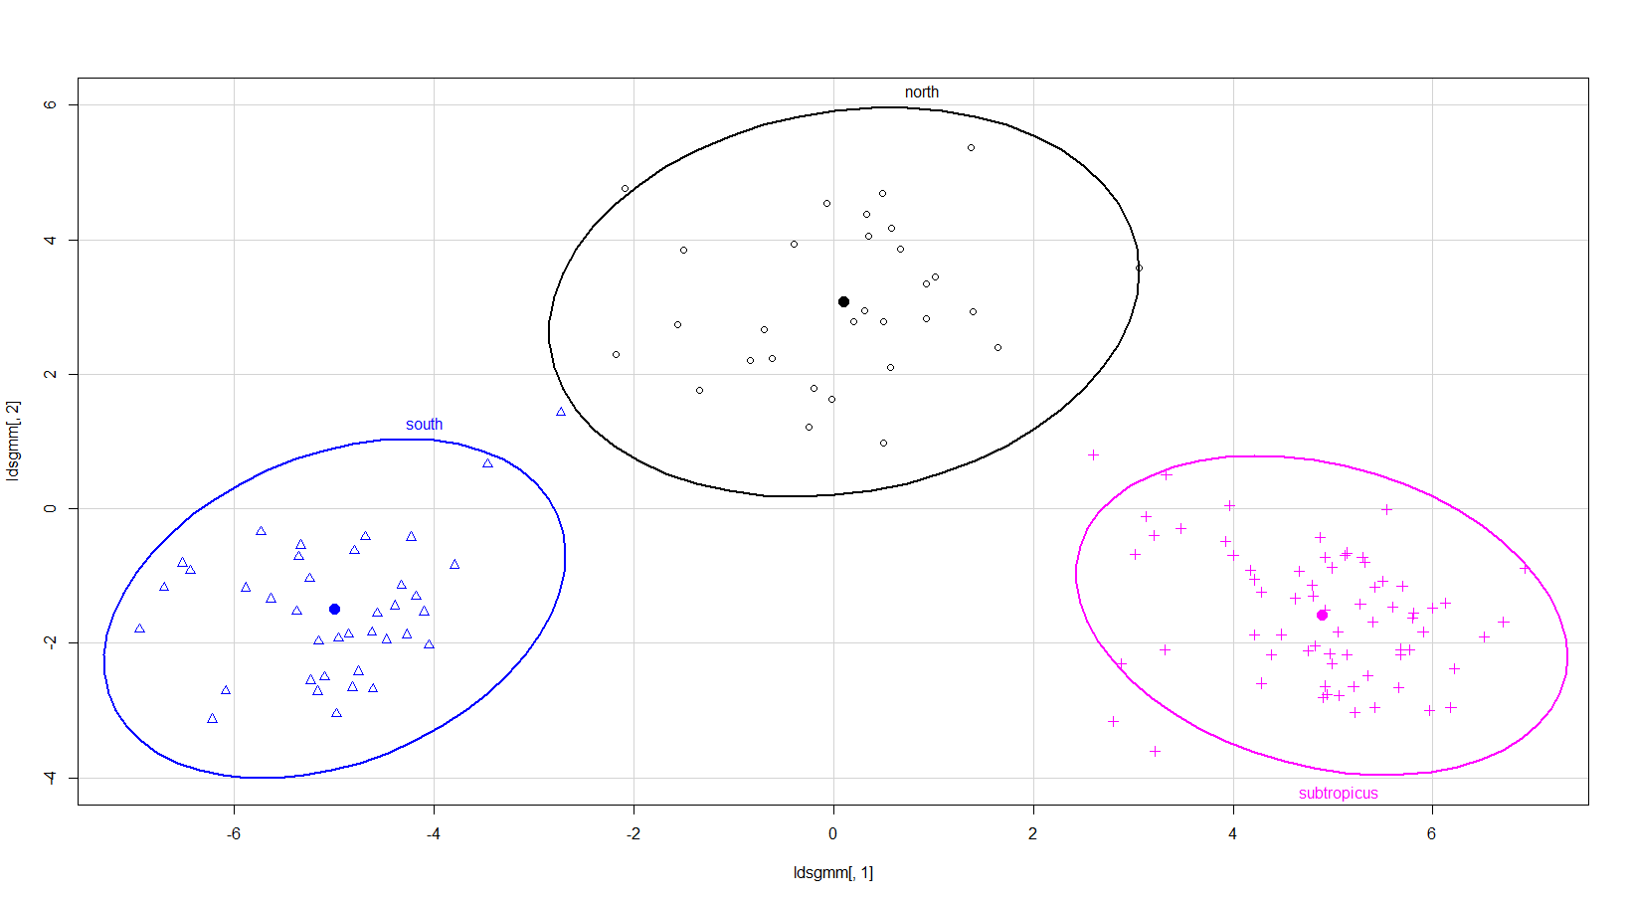

Slide 17
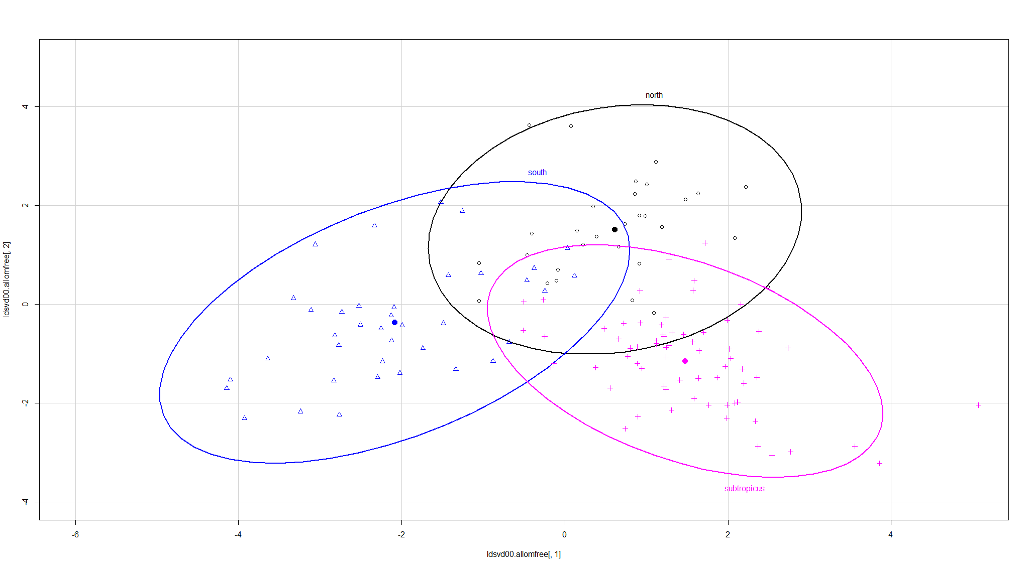

Slide 18
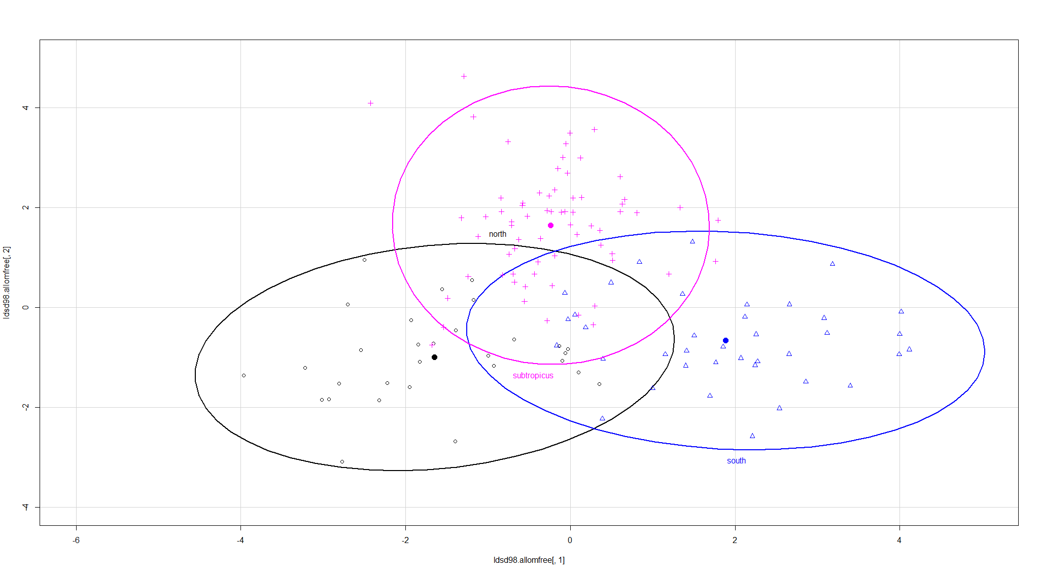

Slide 19
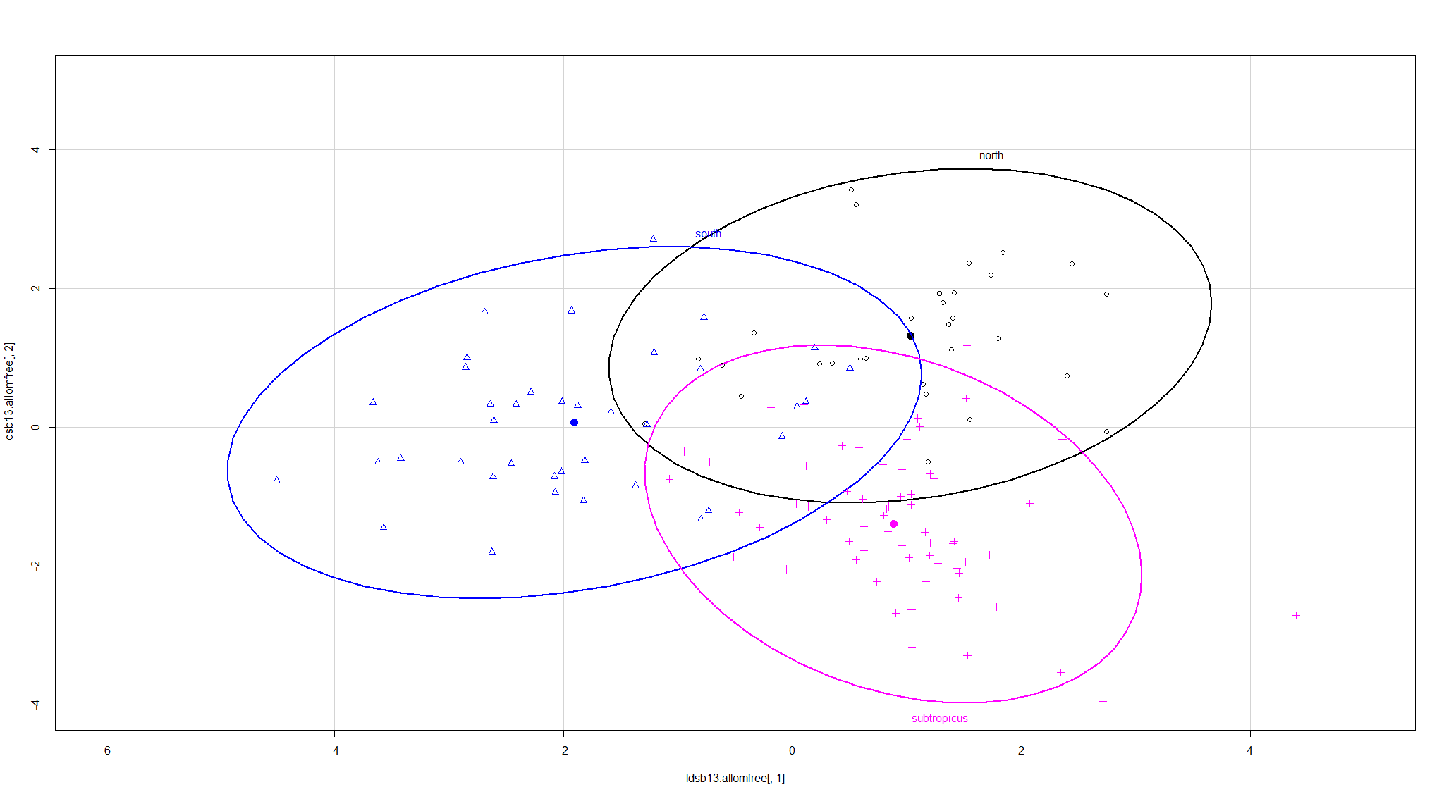

Slide 20
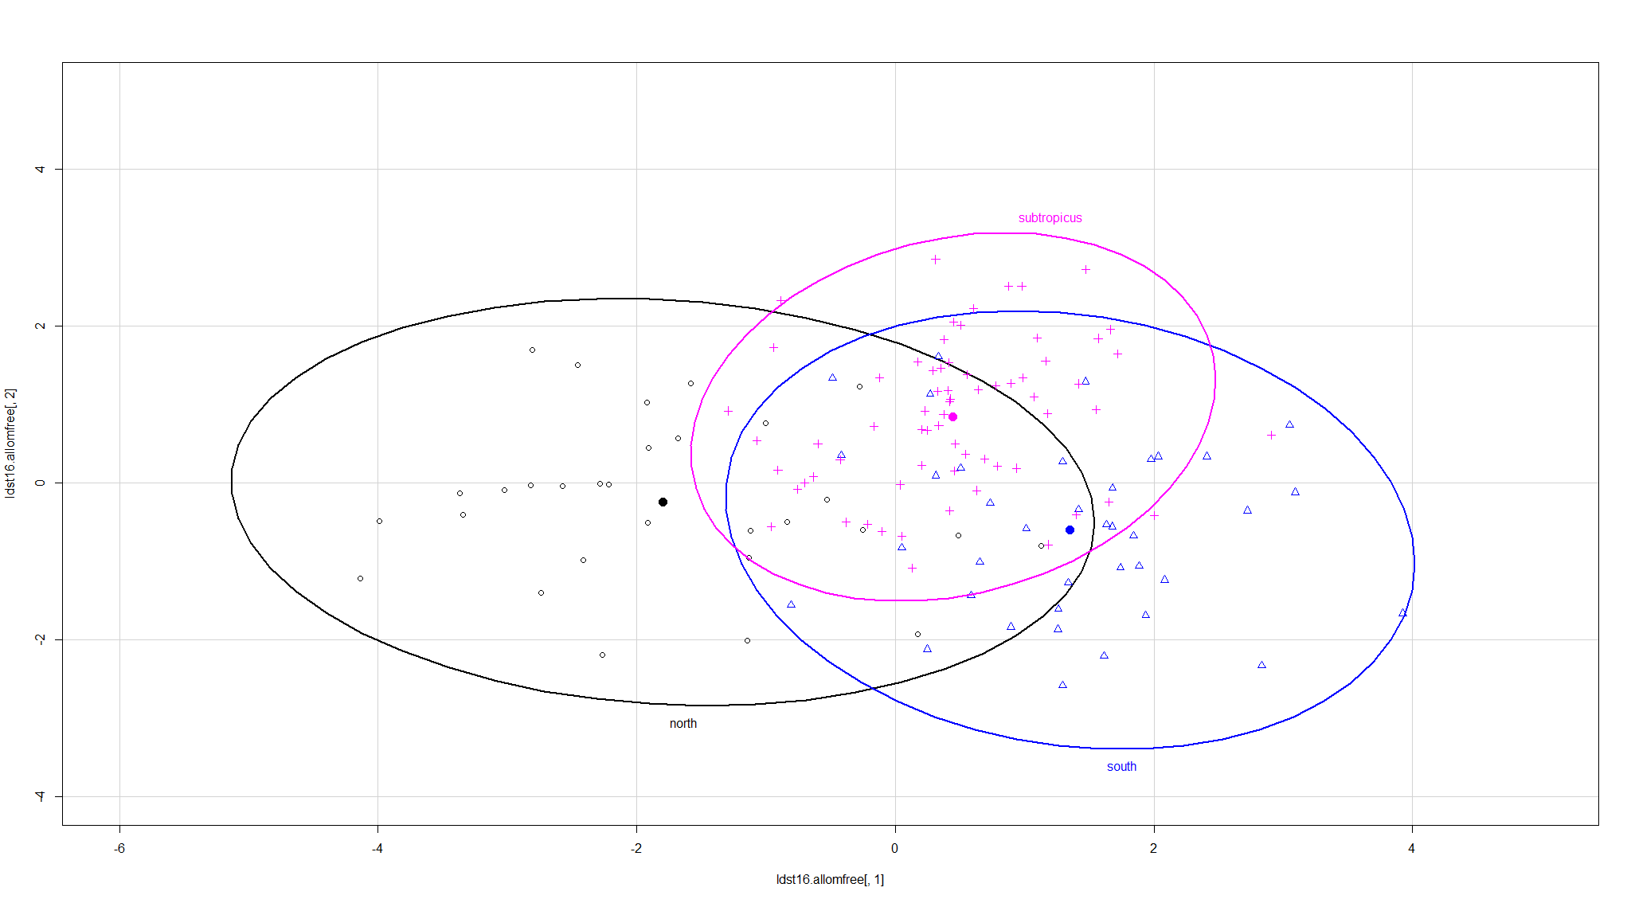

Slide 21
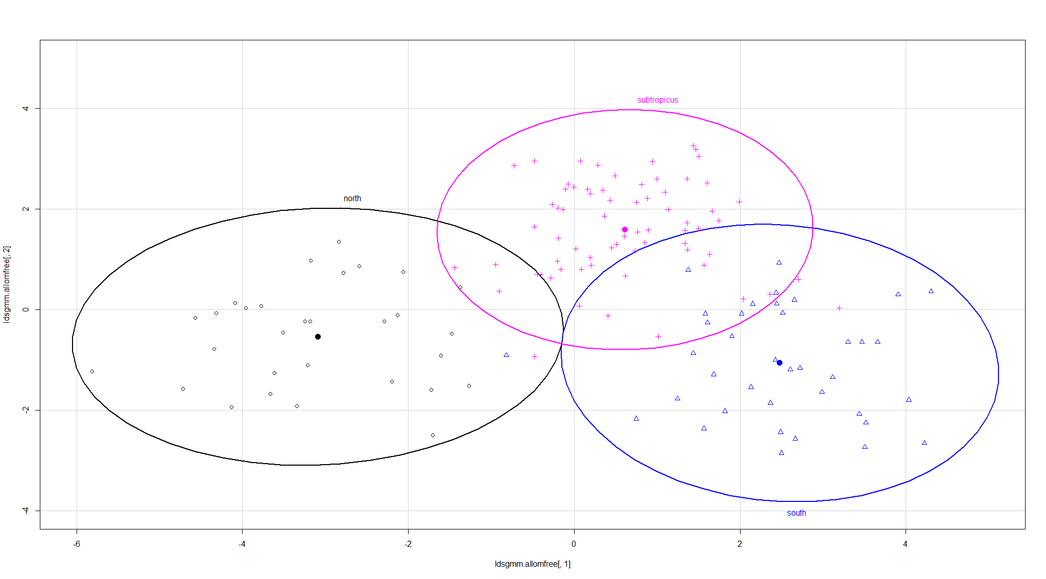
MAKE GGORD PLOTS?!?!?! AND LDA PLOTS SAME AS PCA PLOTS FIG 1 and PCA

Slide 22
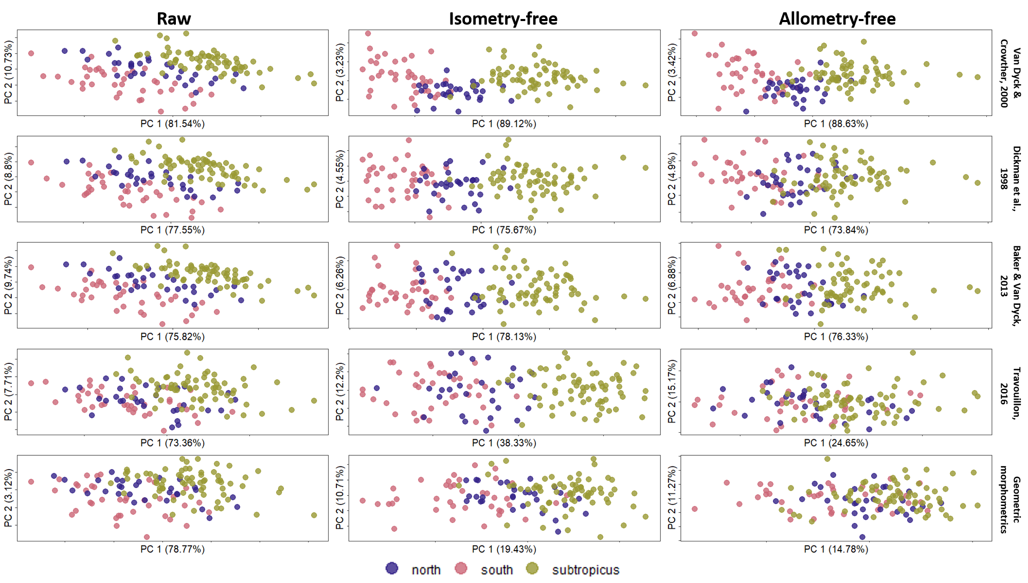
A. stuartii north
A. stuartii south
A. subtropicus

Slide 23
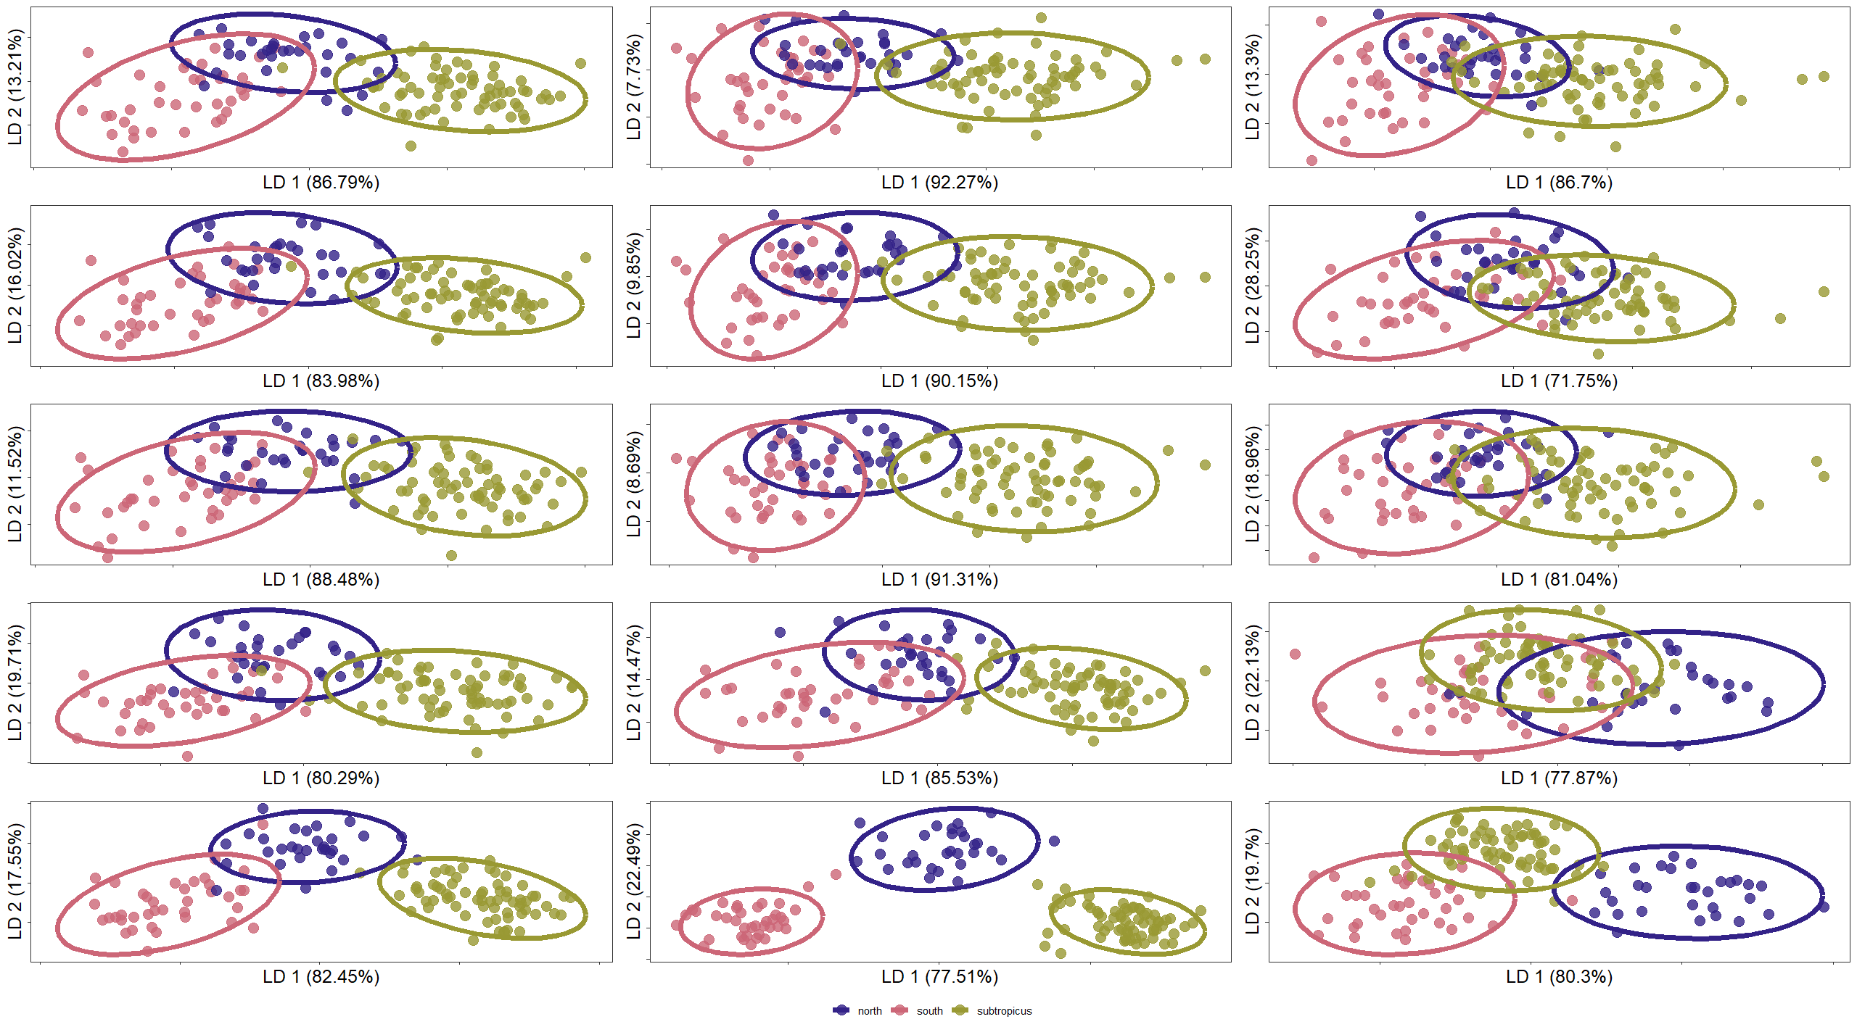
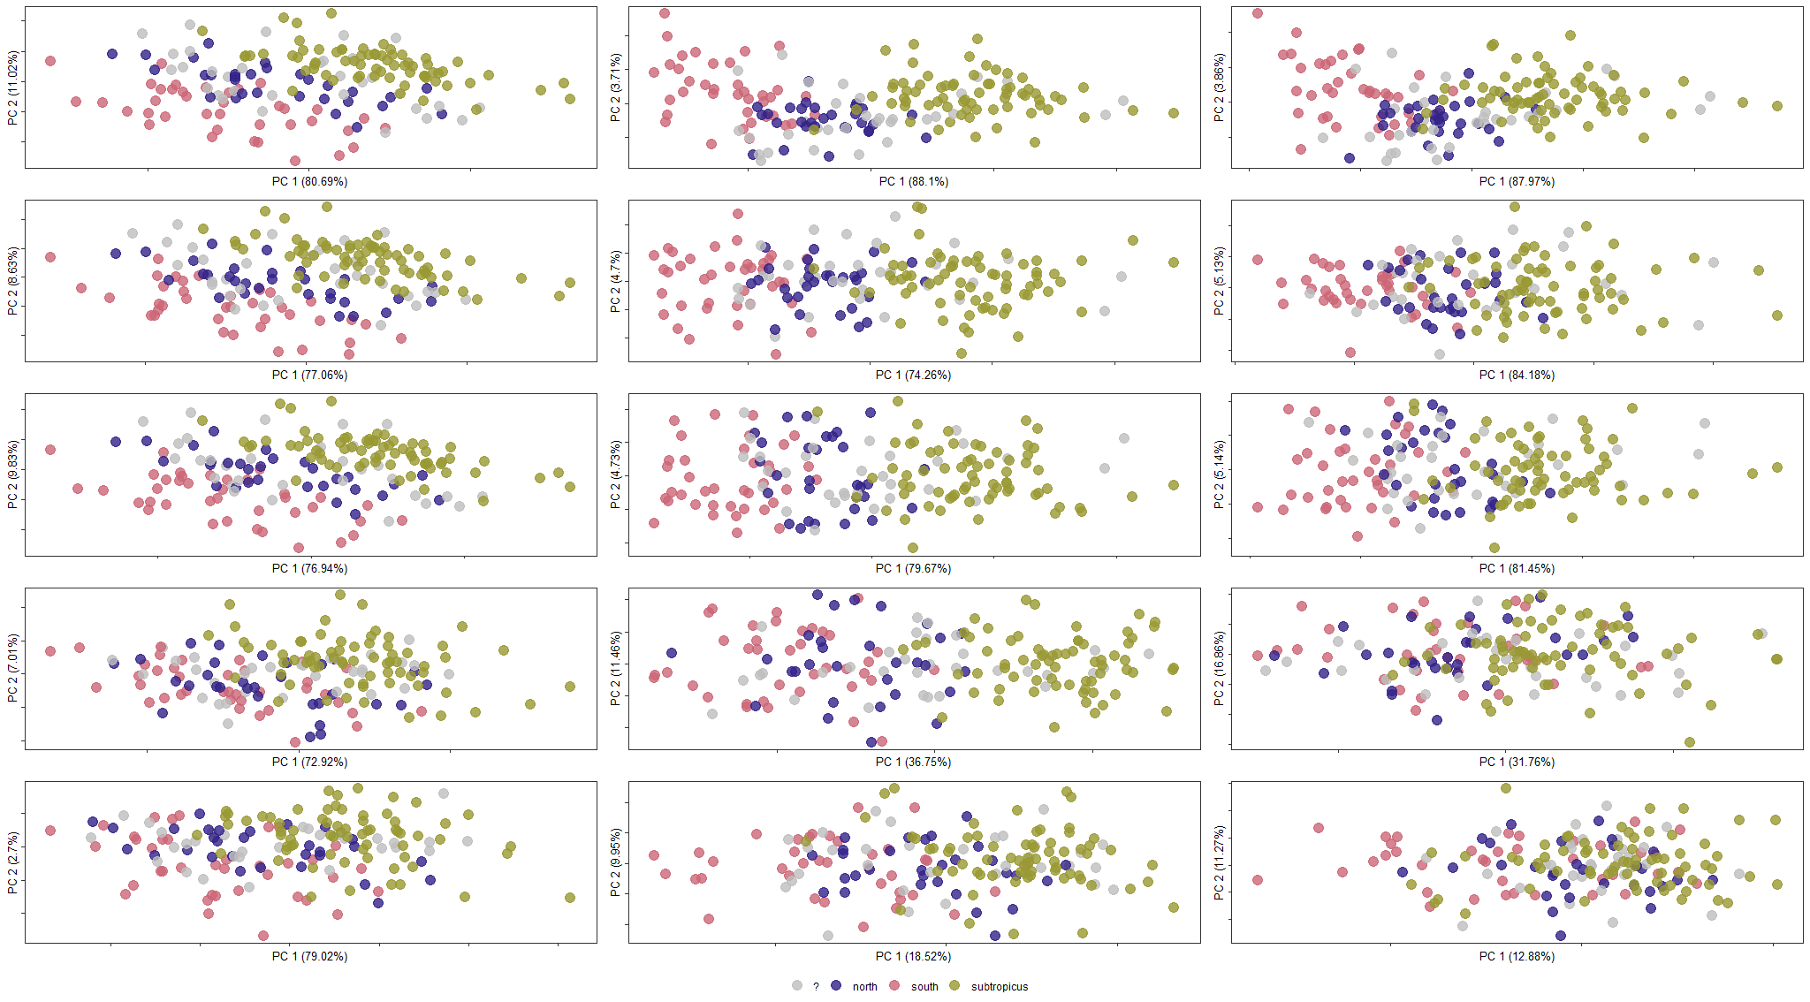
Raw
Isometry-free
Allometry-free
Van Dyck & Crowther, 2000
Dickman et al., 1998
Baker & Van Dyck, 2013
Travouillon, 2016
Geometric morphometrics
A. stuartii north
A. stuartii south
A. subtropicus

Slide 24
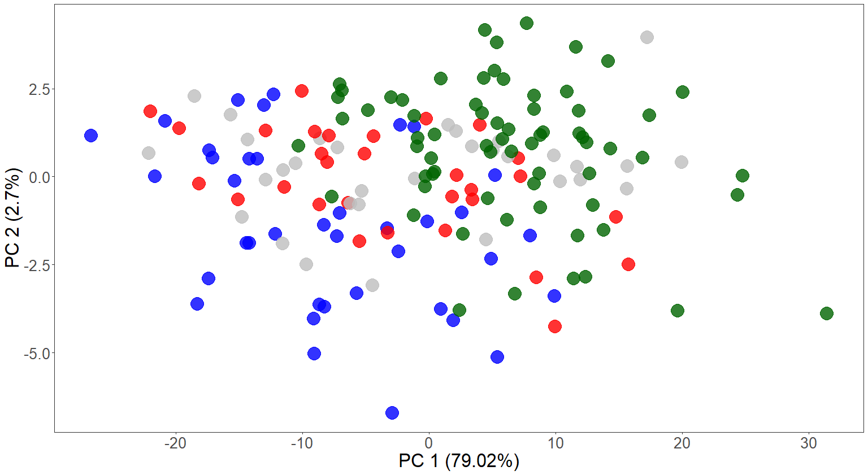
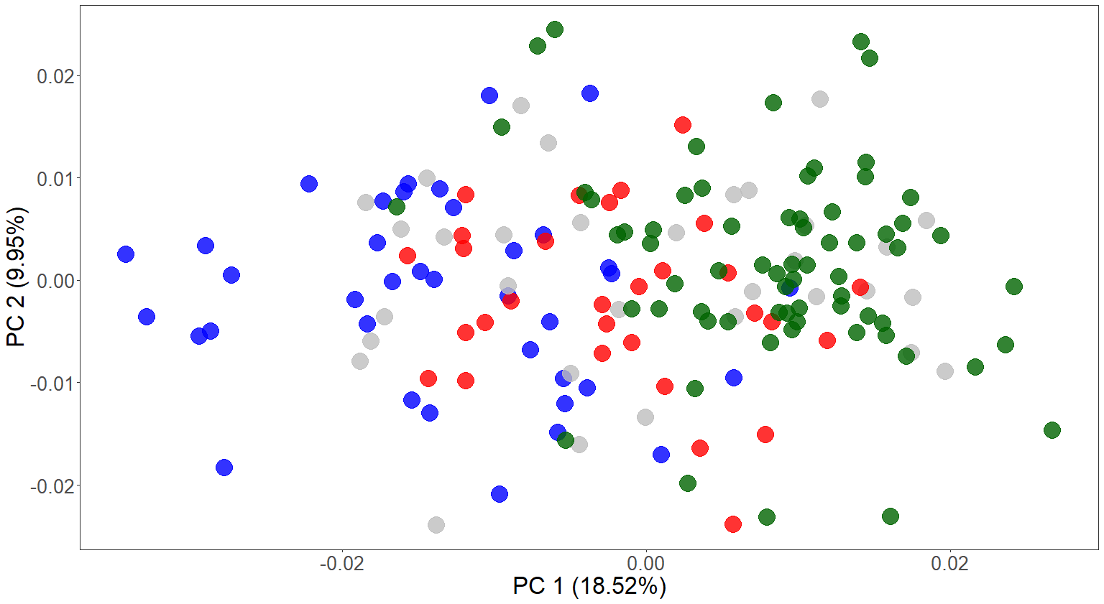
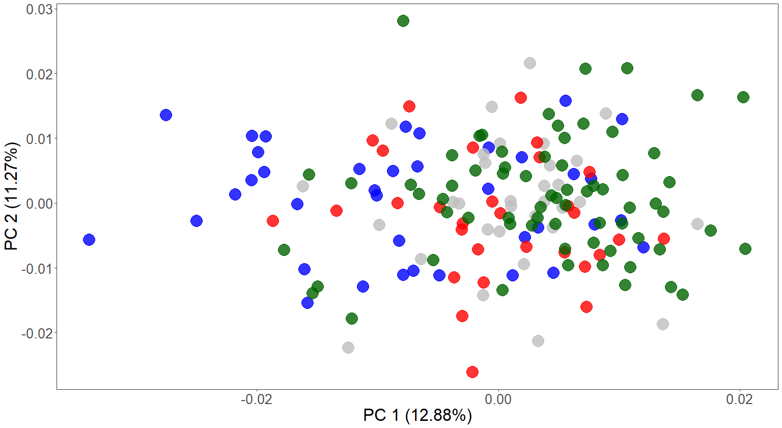
Partial procrustes
Full procrustes
Allometry residuals

Slide 25
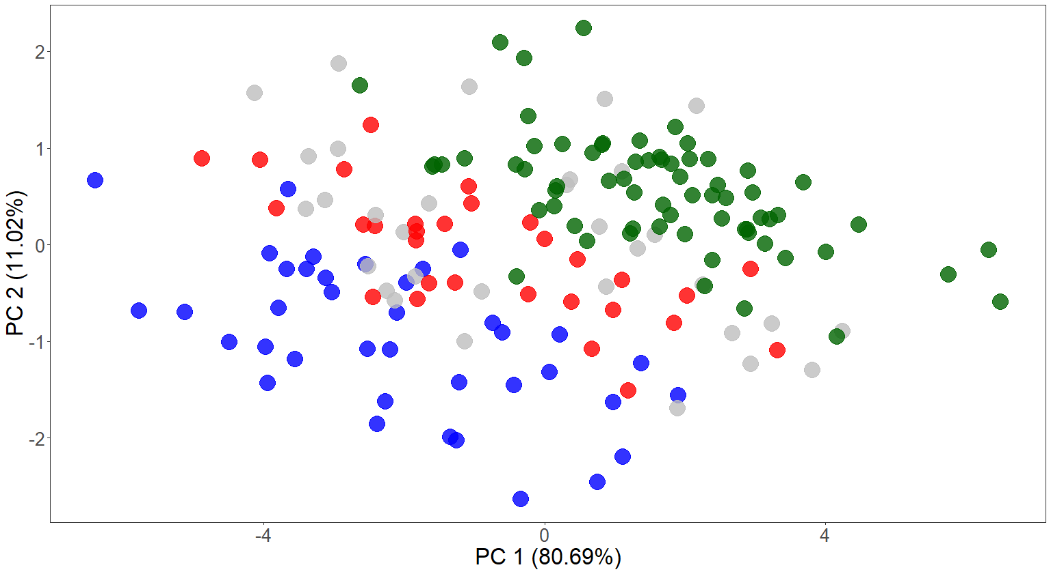
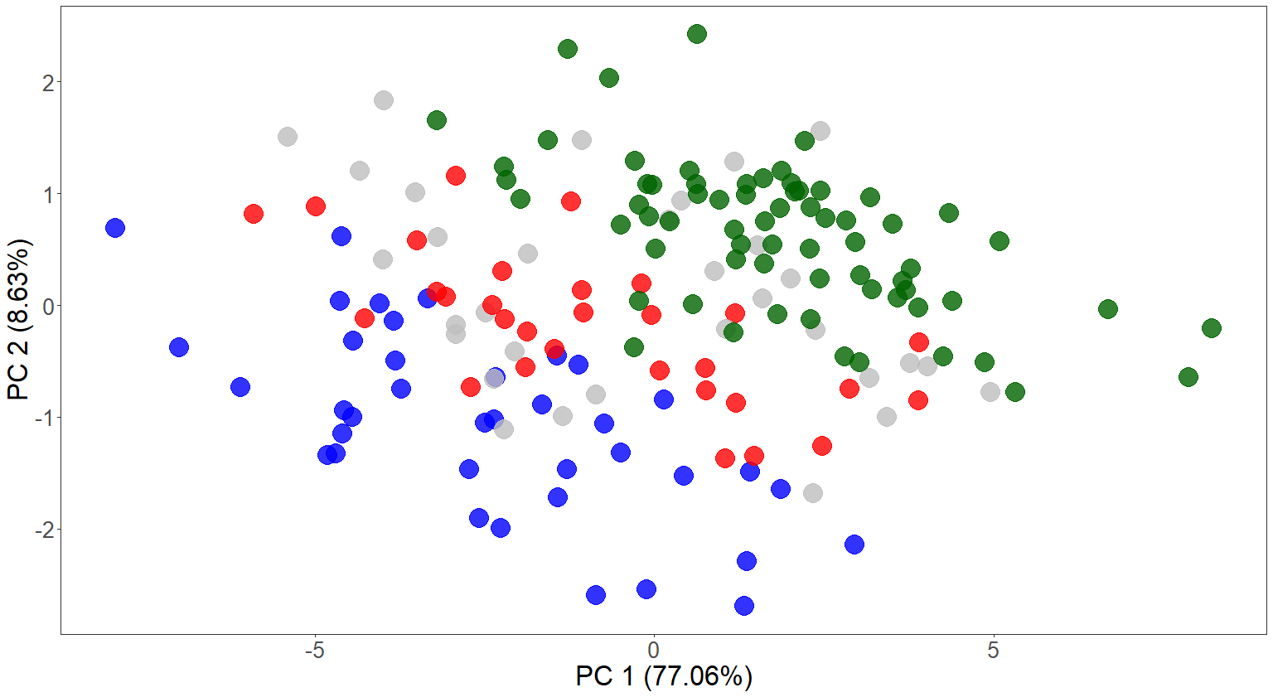
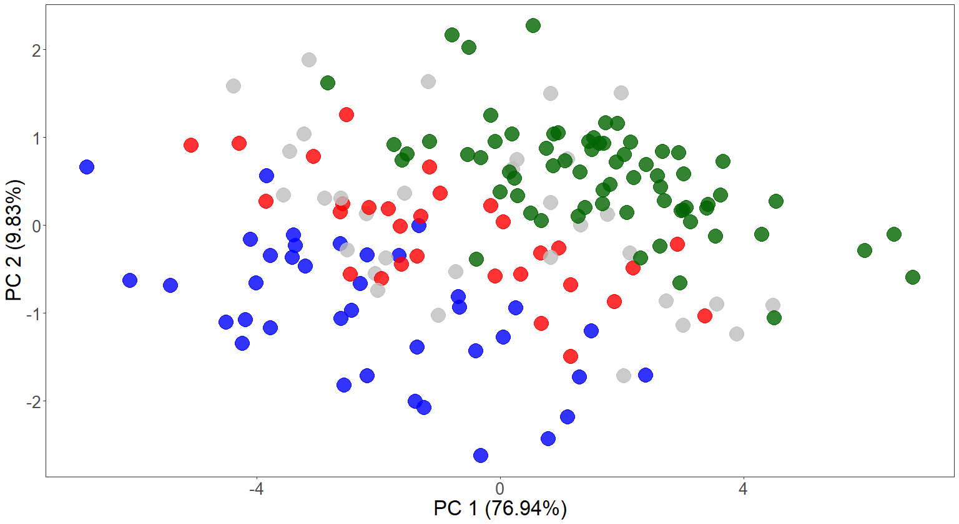
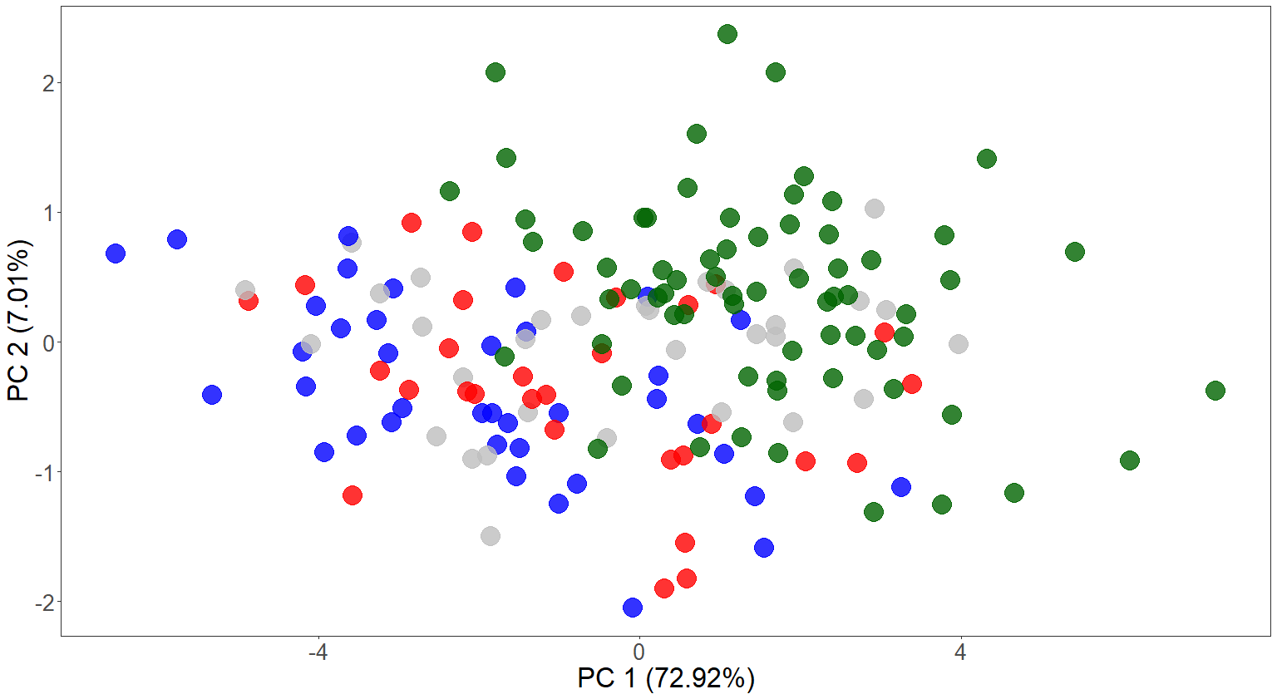
Van Dyck & Crowther, 2000
Dickman et al., 1998
Baker & Van Dyck, 2013
Travouillon, 2016
LMM PCAs without size treatment (raw LMM)

Slide 26
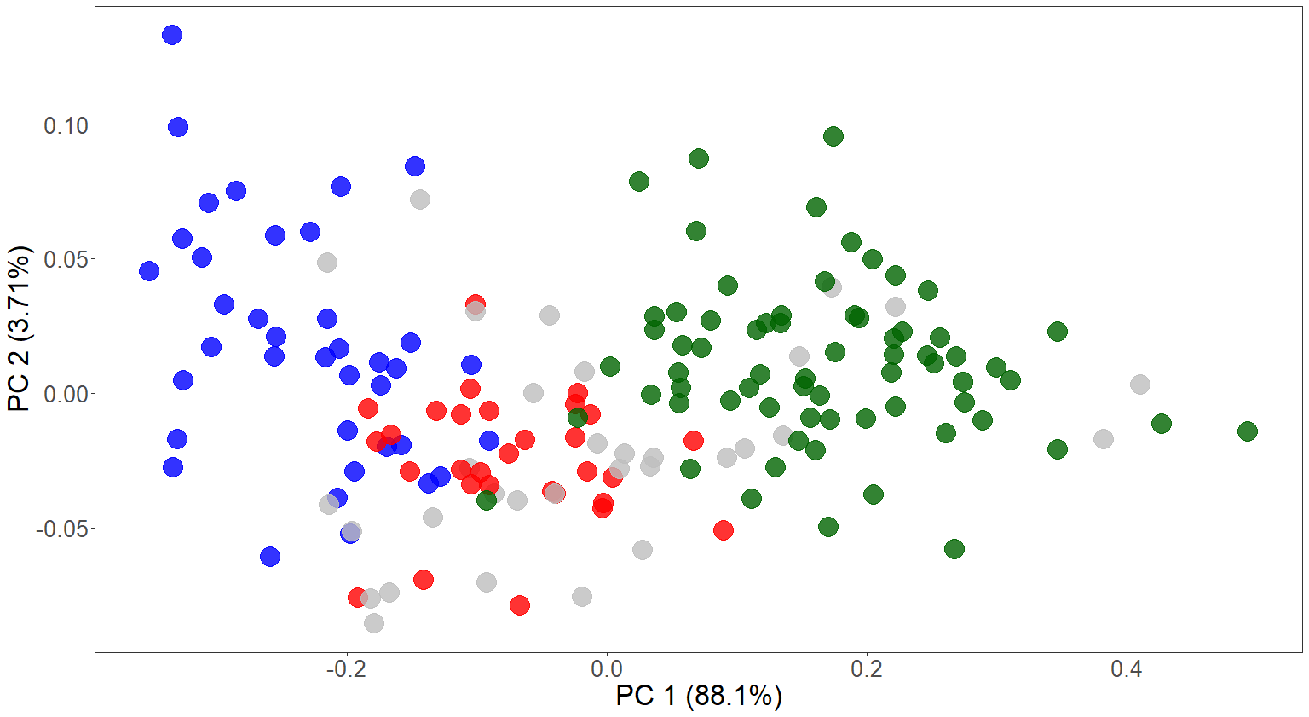
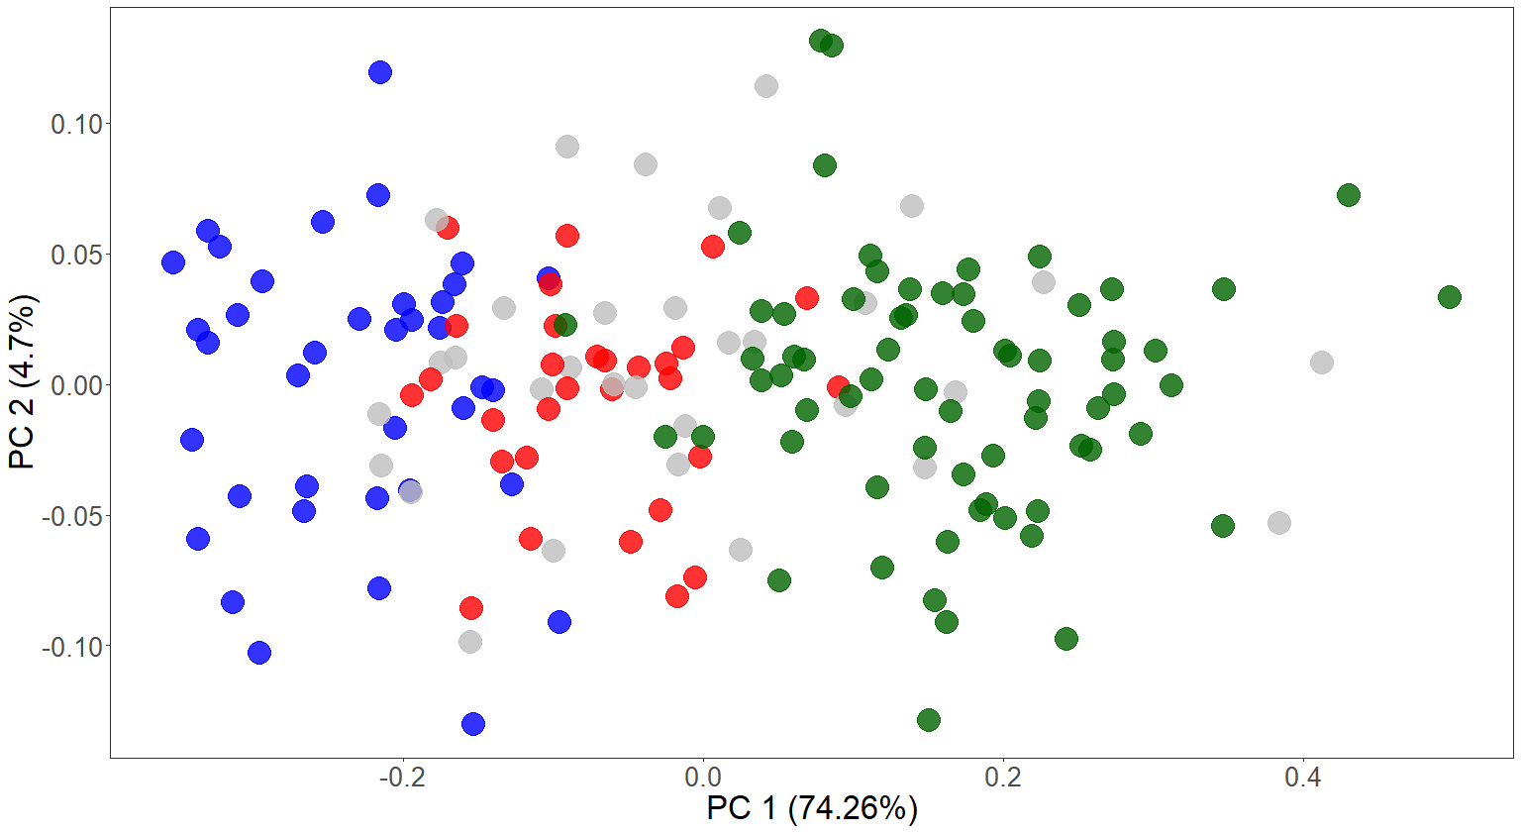
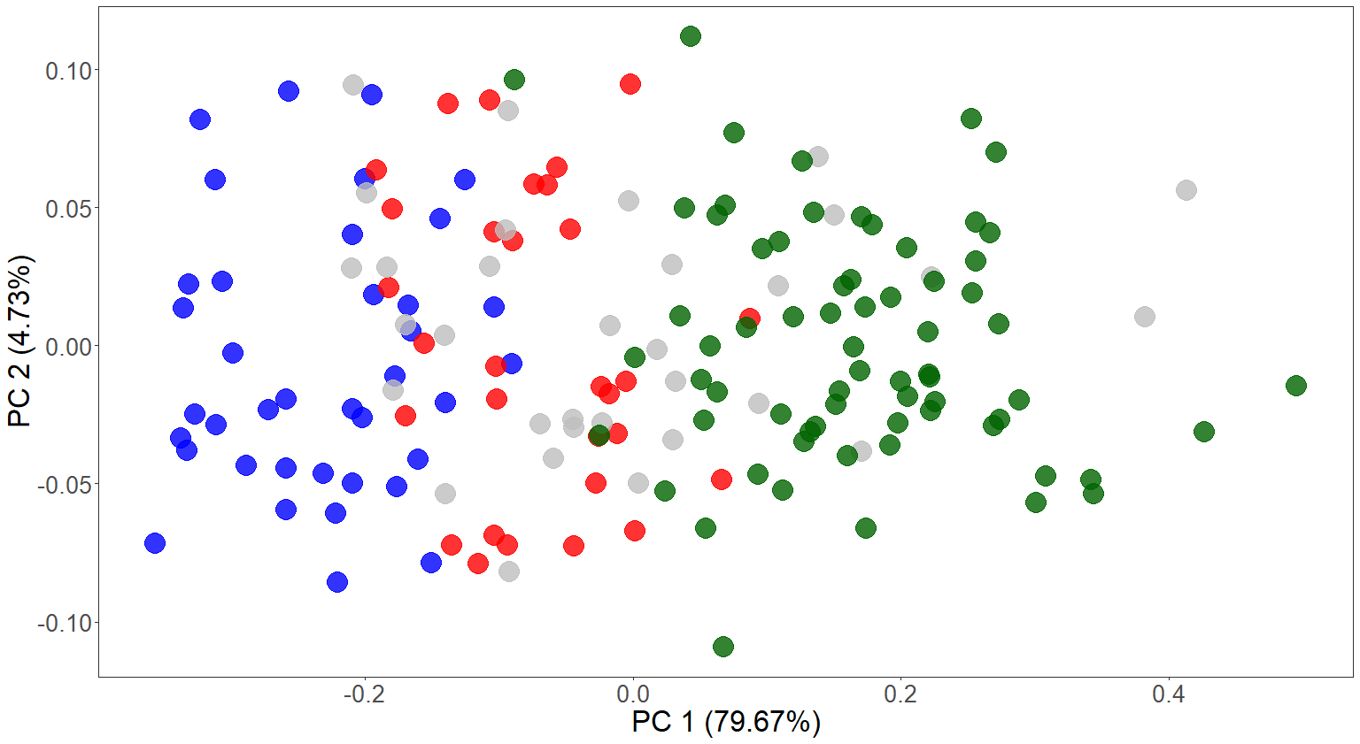
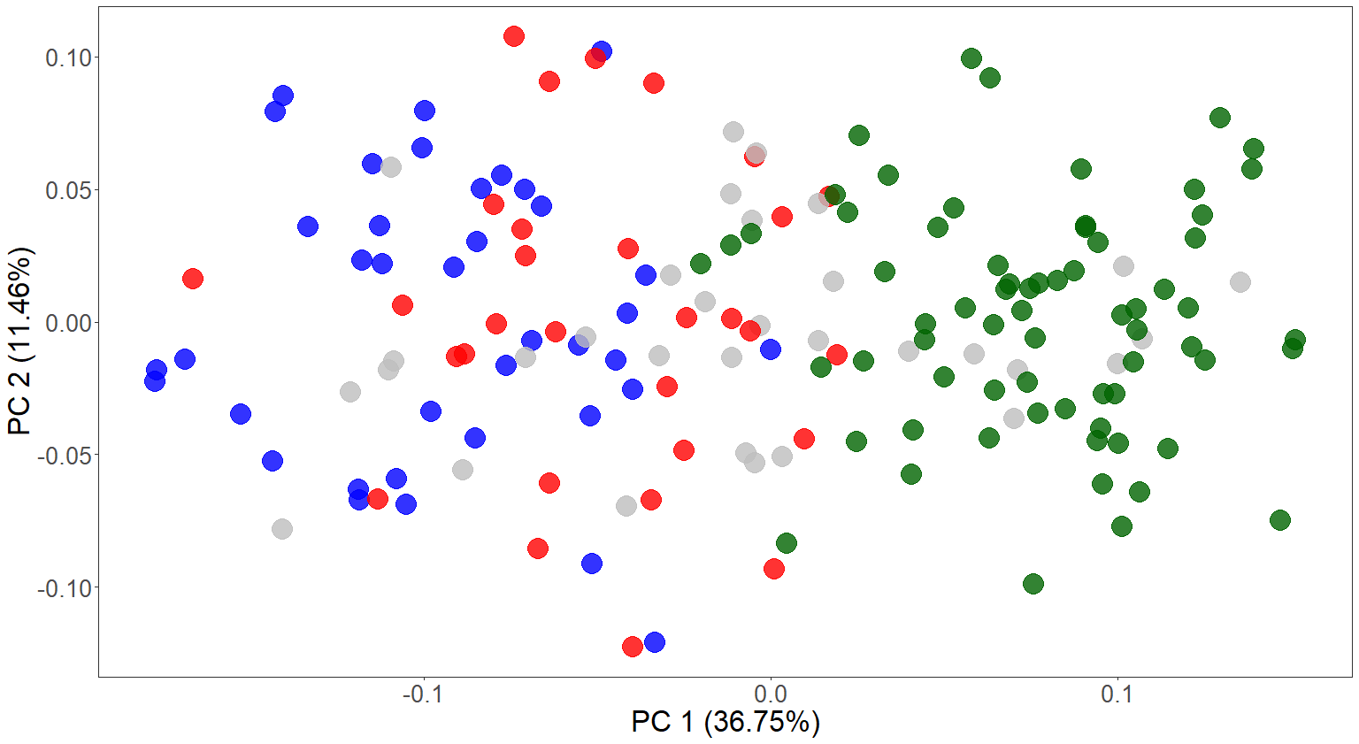
Van Dyck & Crowther, 2000
Dickman et al., 1998
Baker & Van Dyck, 2013
Travouillon, 2016
LMM PCAs after size treatment

Slide 27
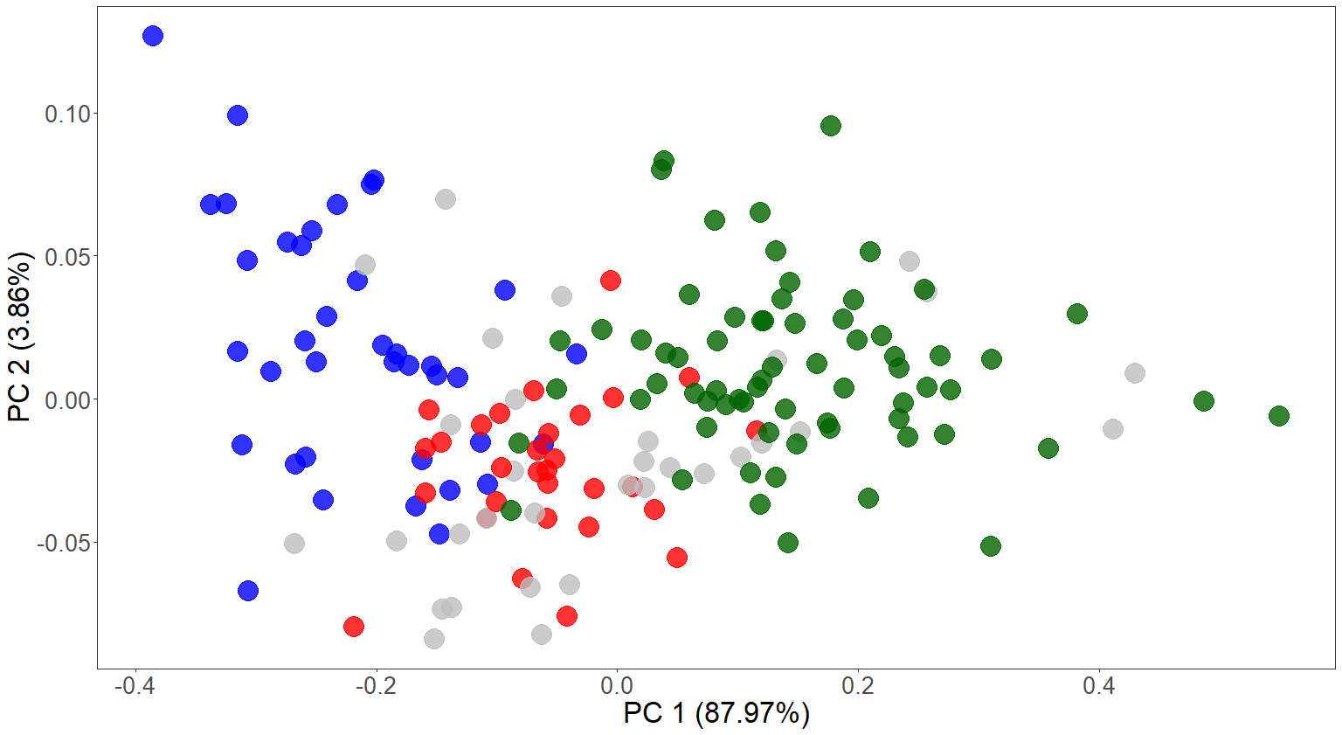
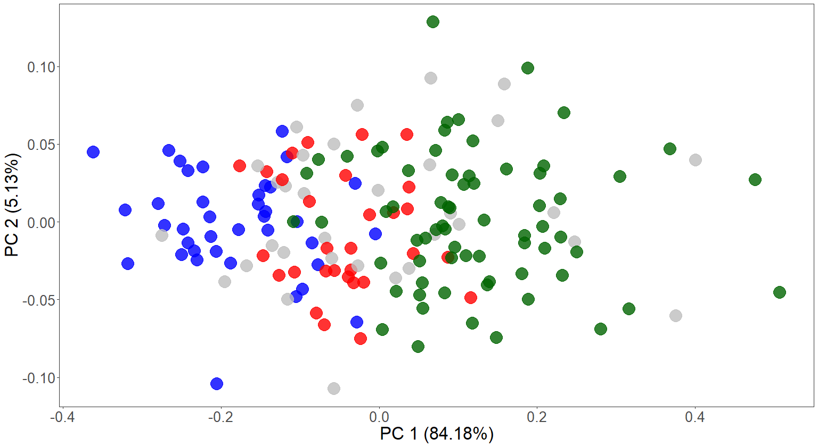
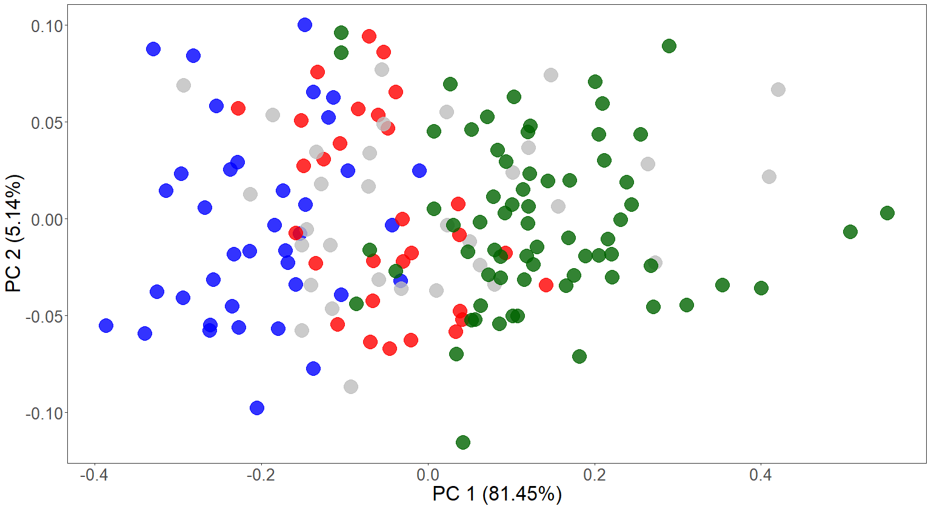
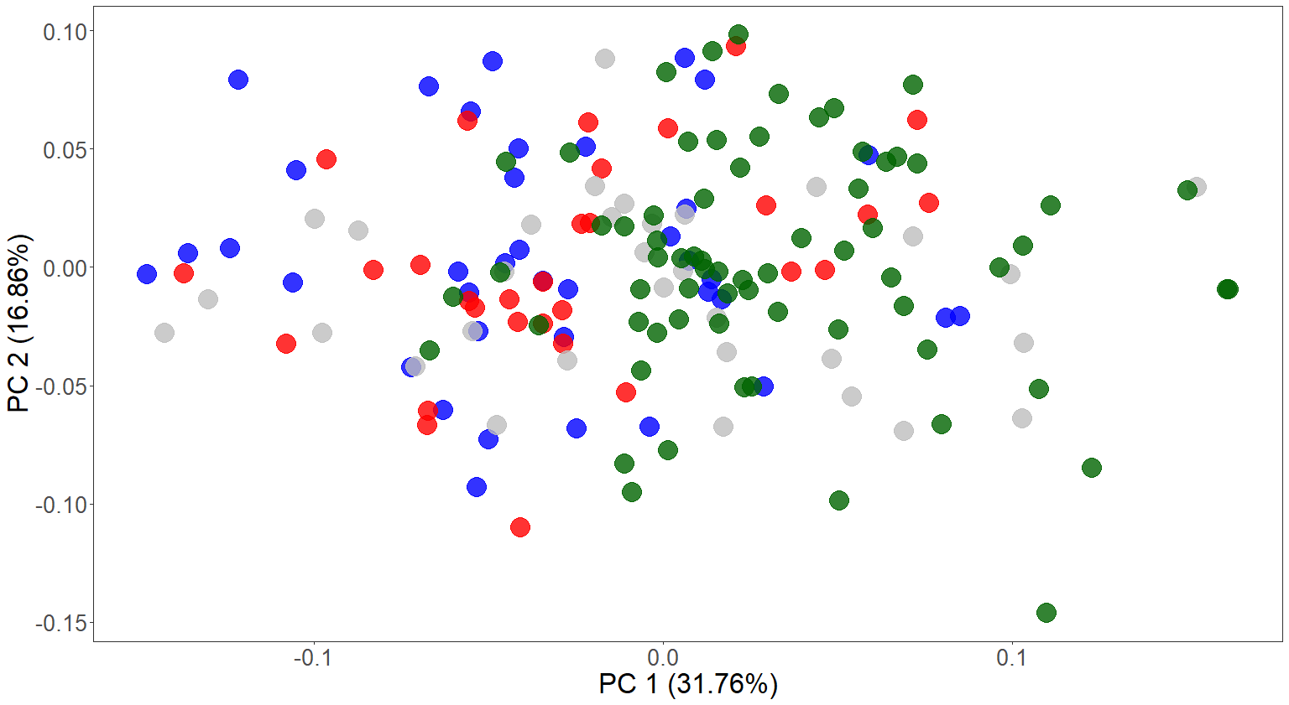
Van Dyck & Crowther, 2000
Dickman et al., 1998
Baker & Van Dyck, 2013
Travouillon, 2016
LMM PCAs after allometry treatment

Slide 28
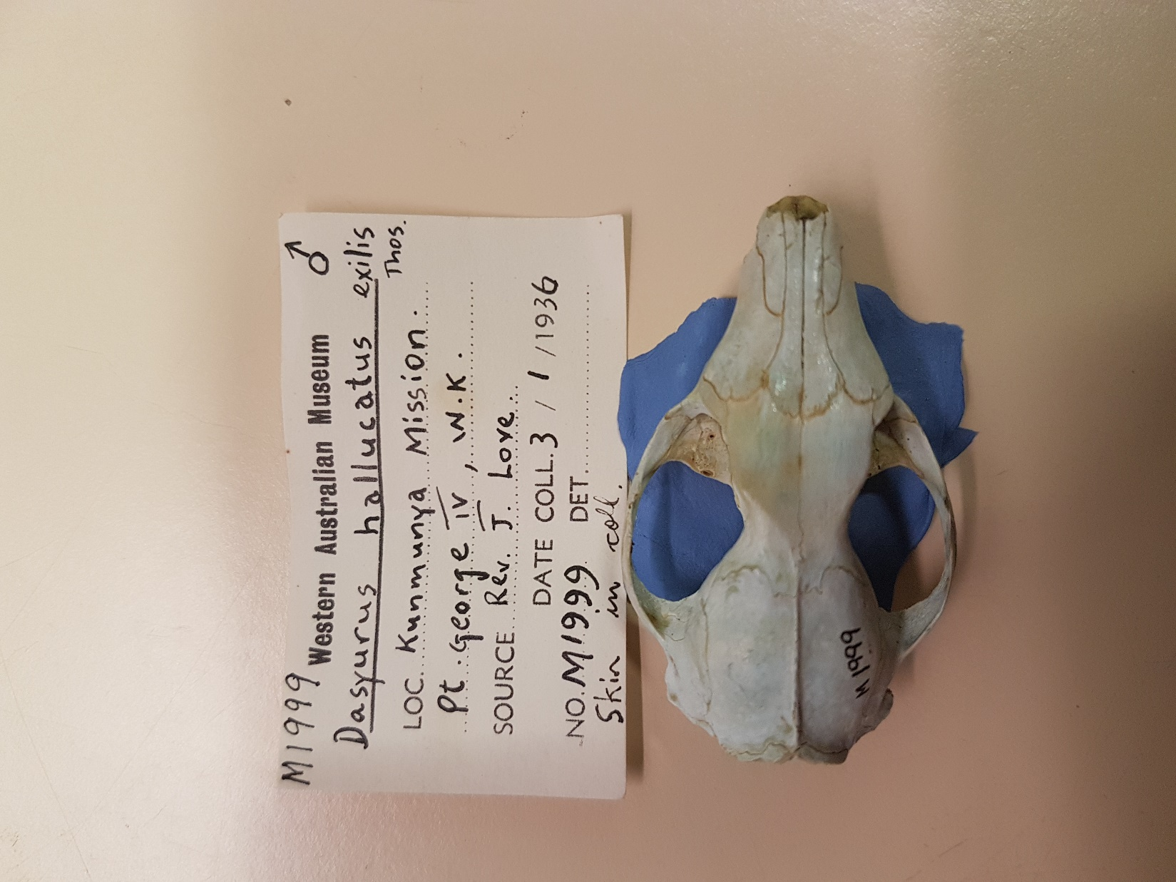
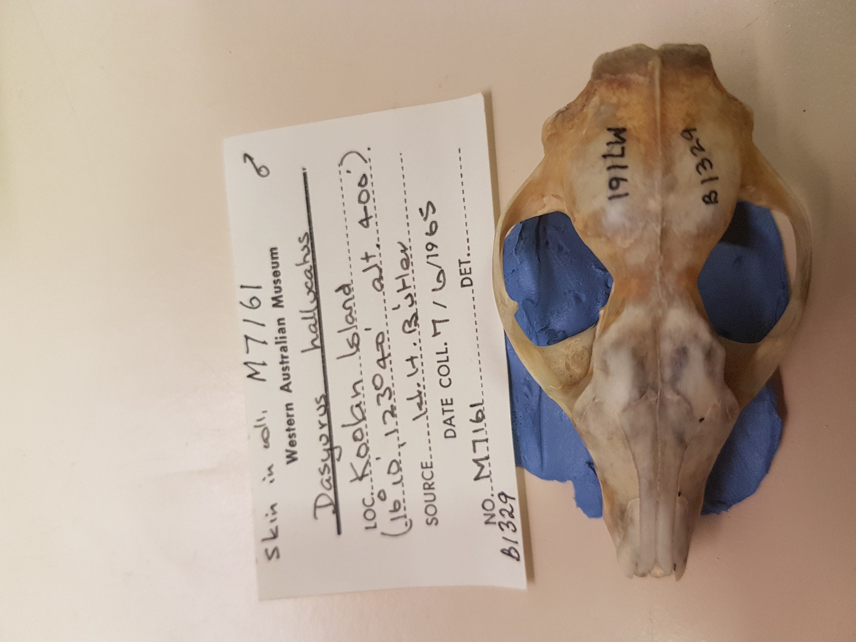
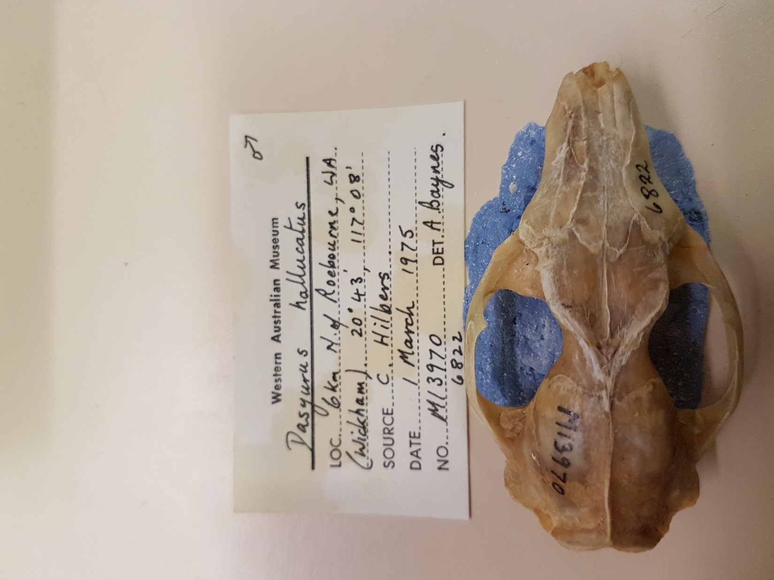

Slide 29
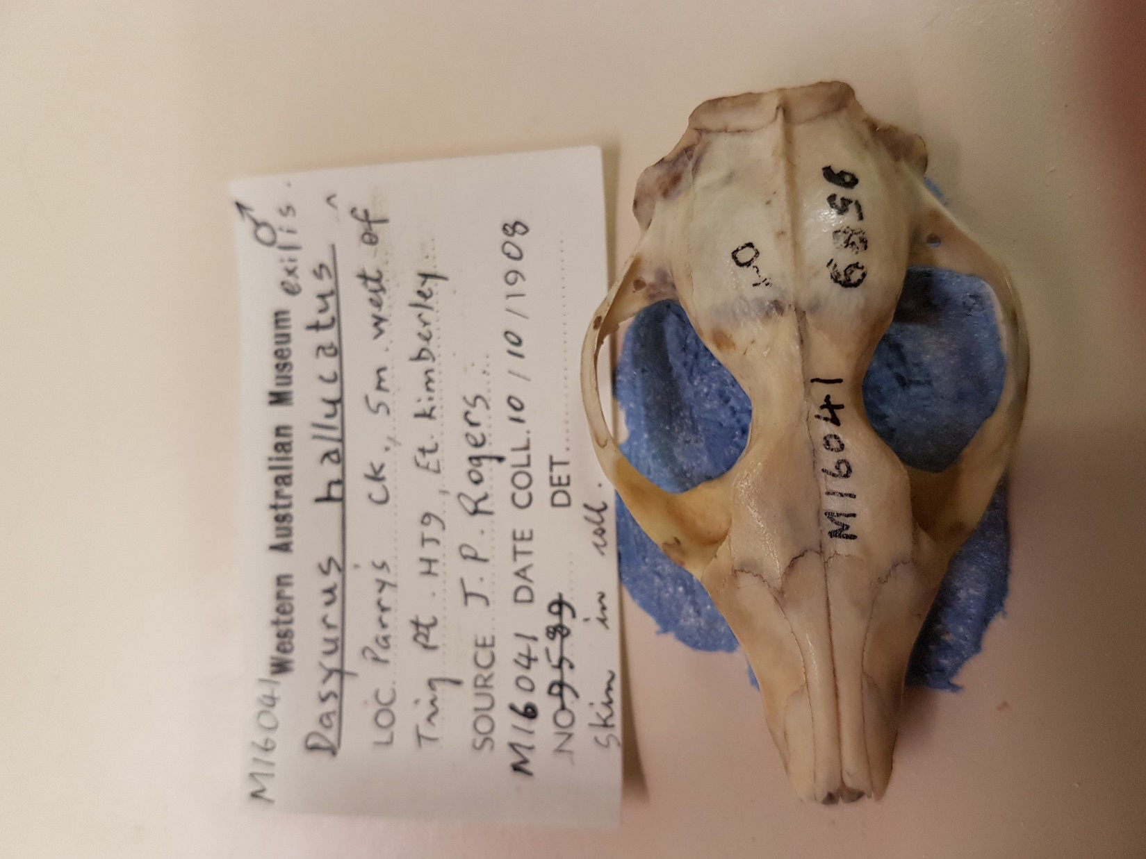
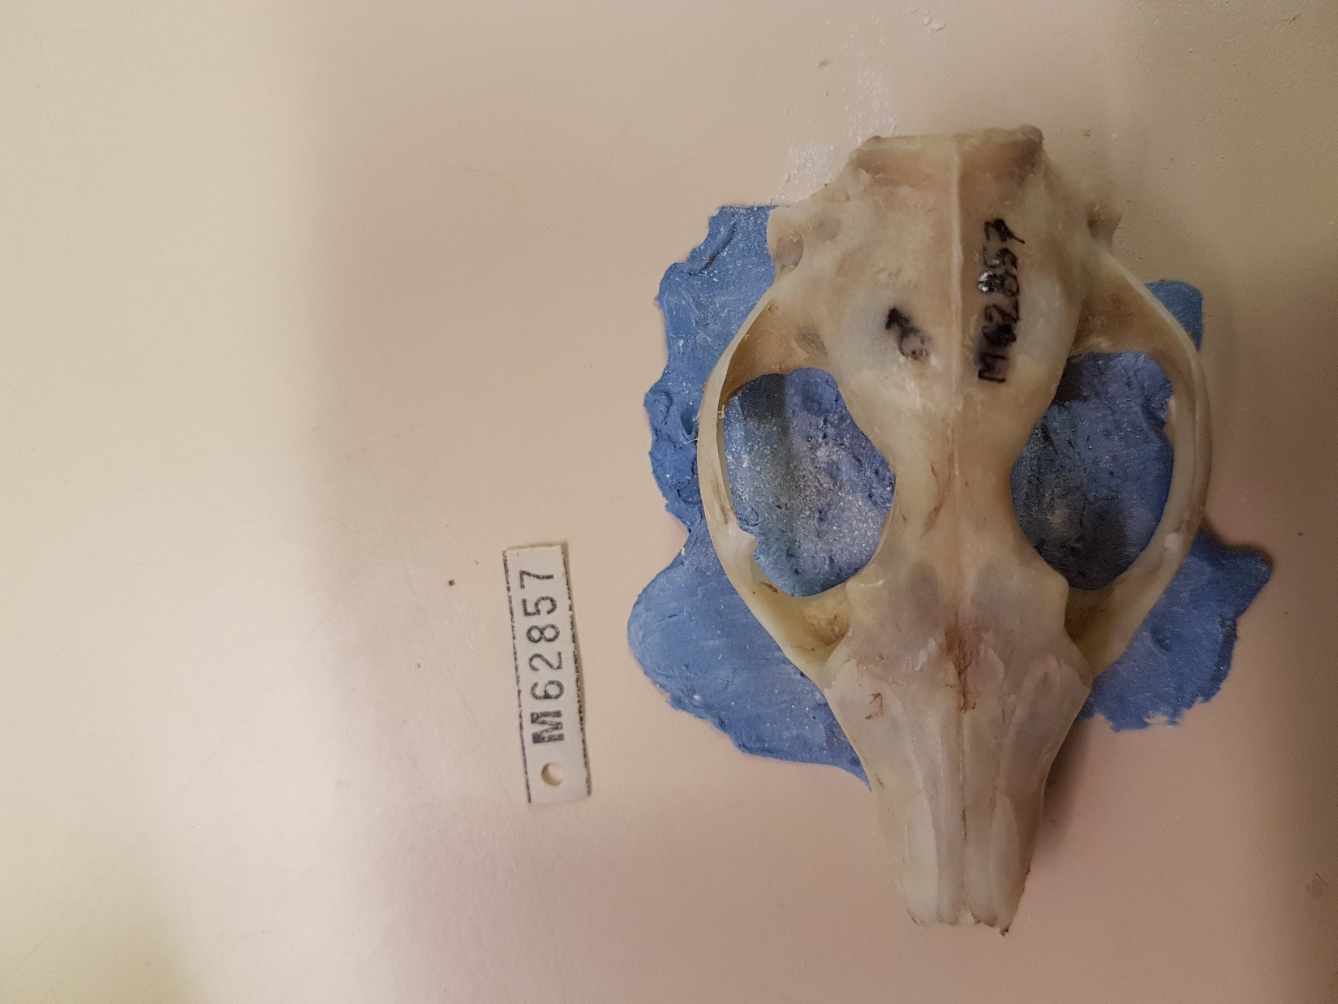
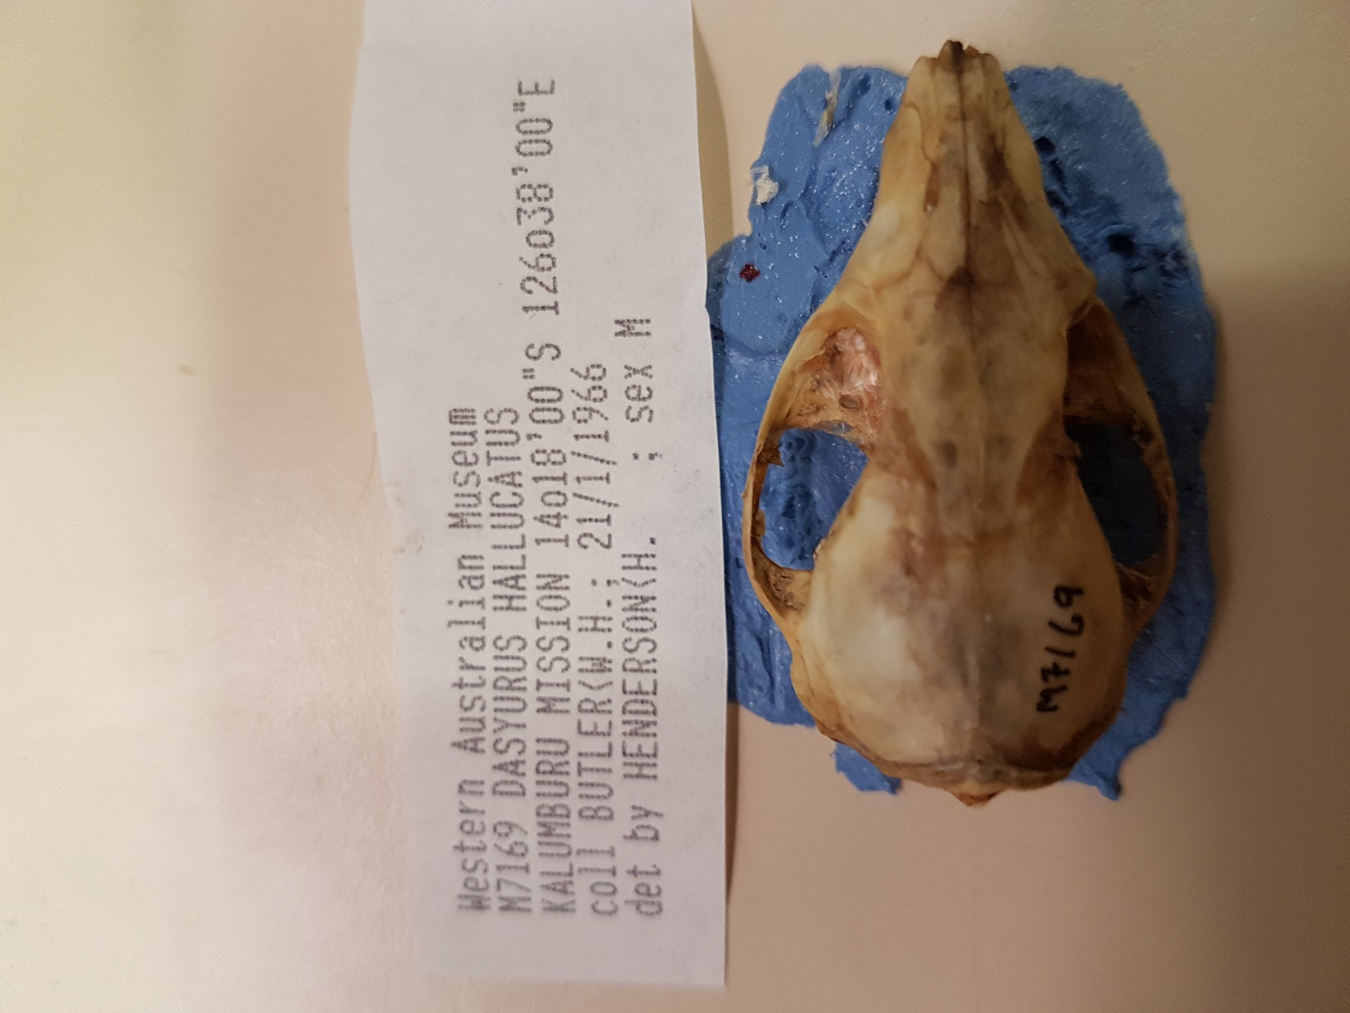

Slide 30
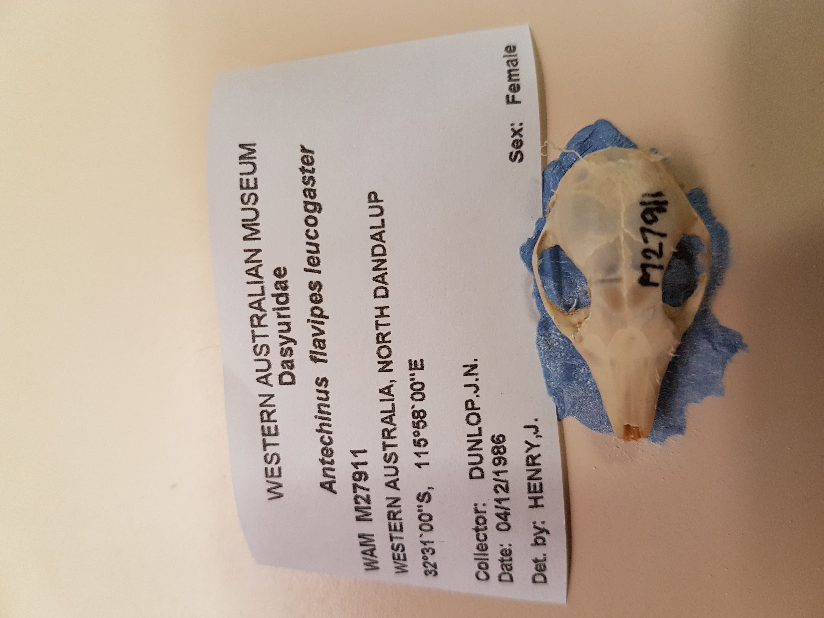
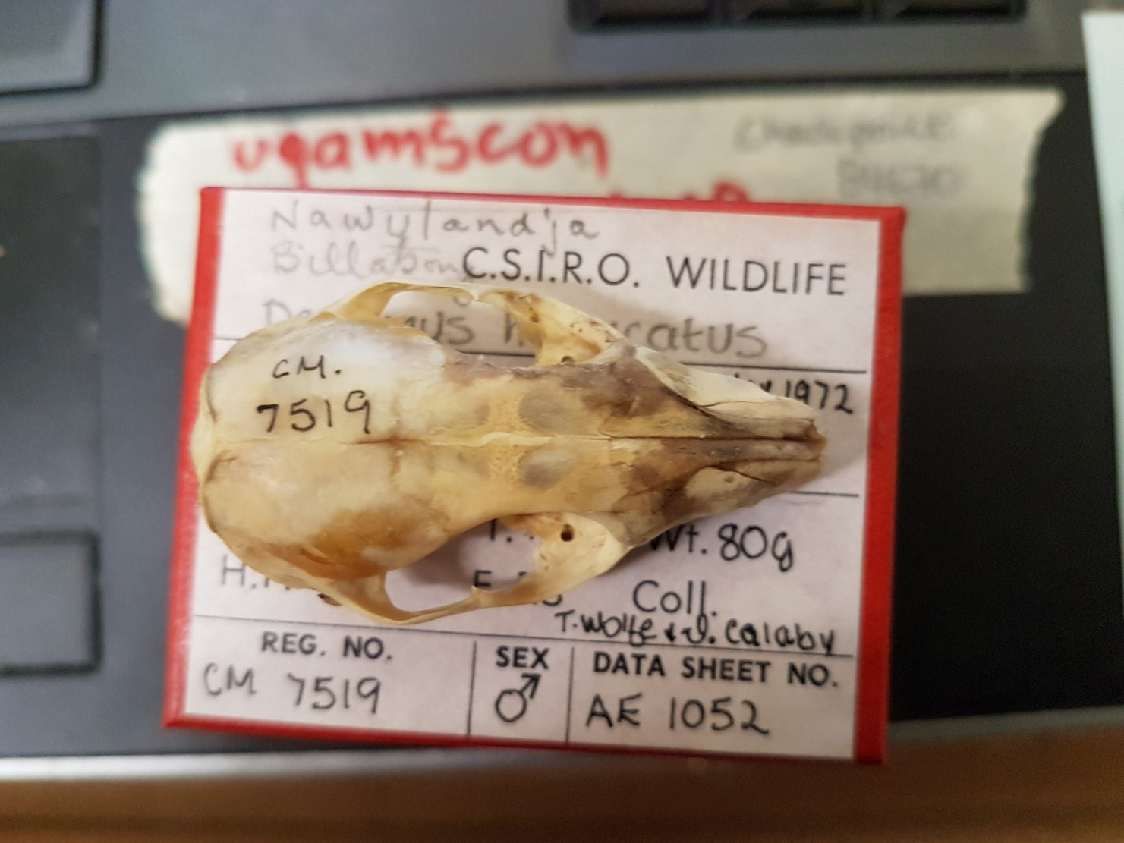

Slide 31
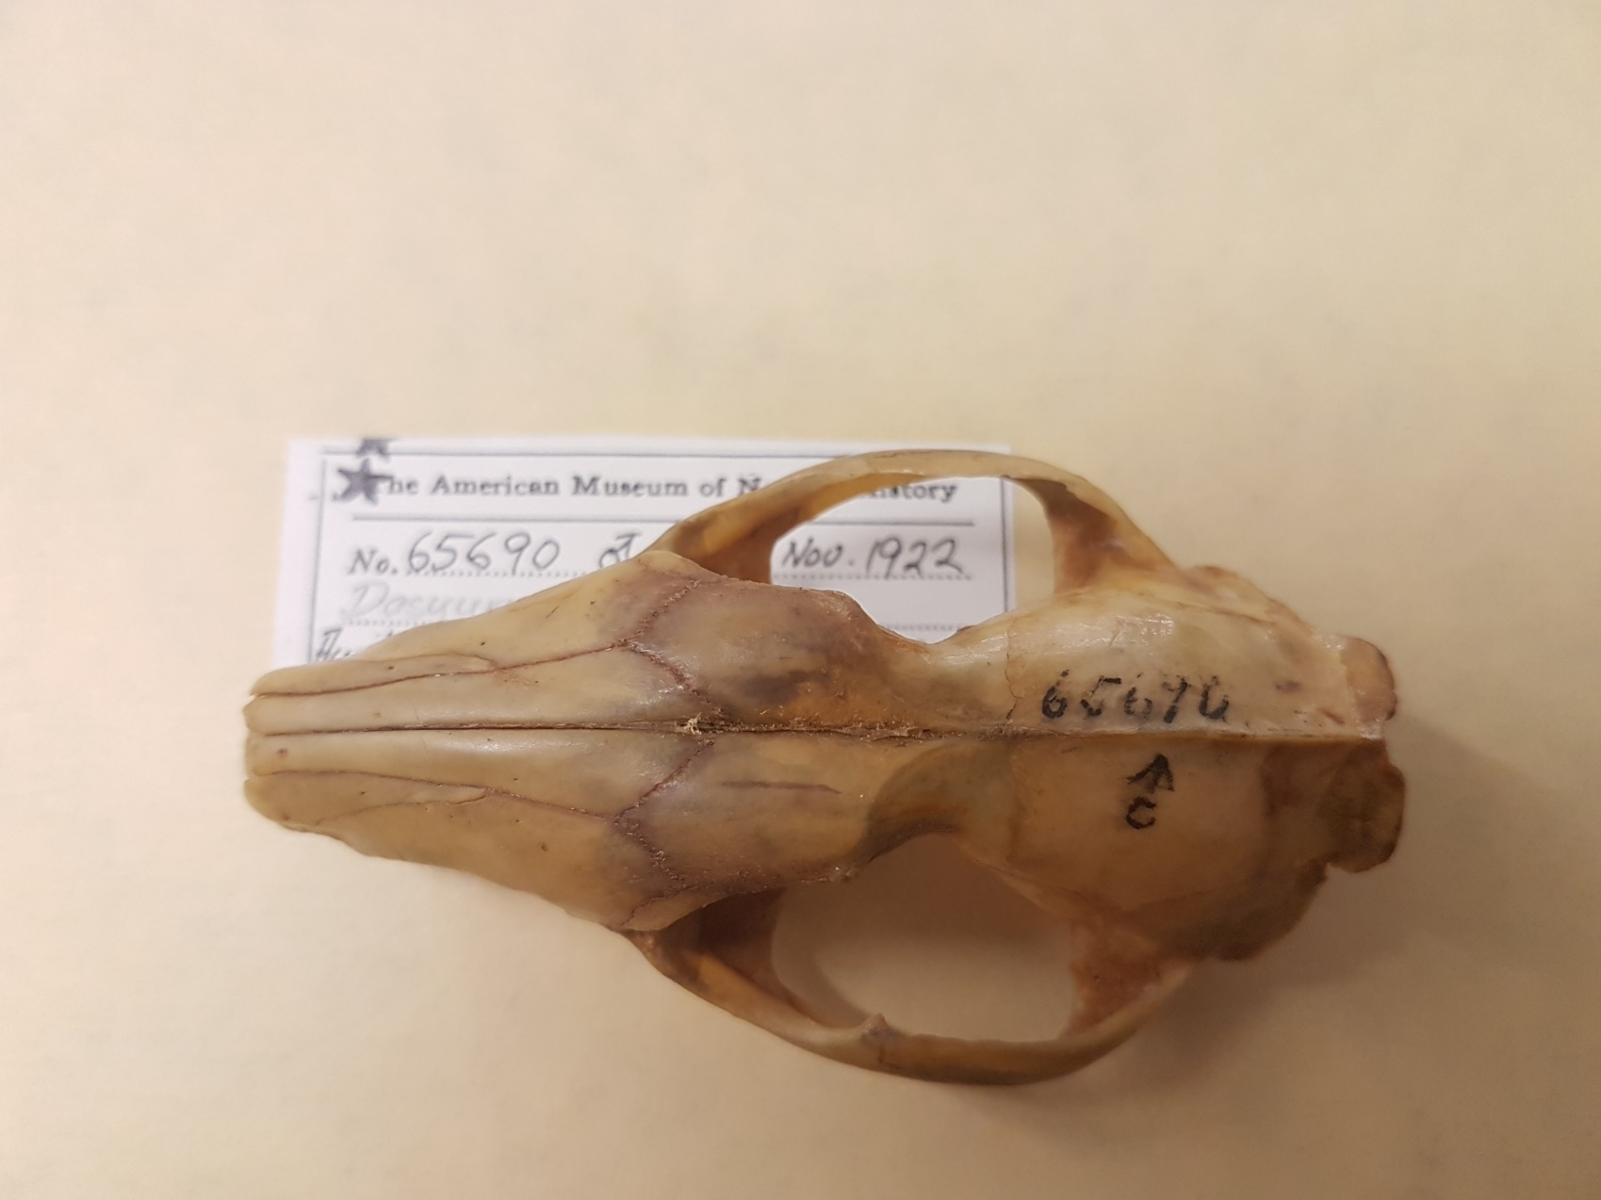
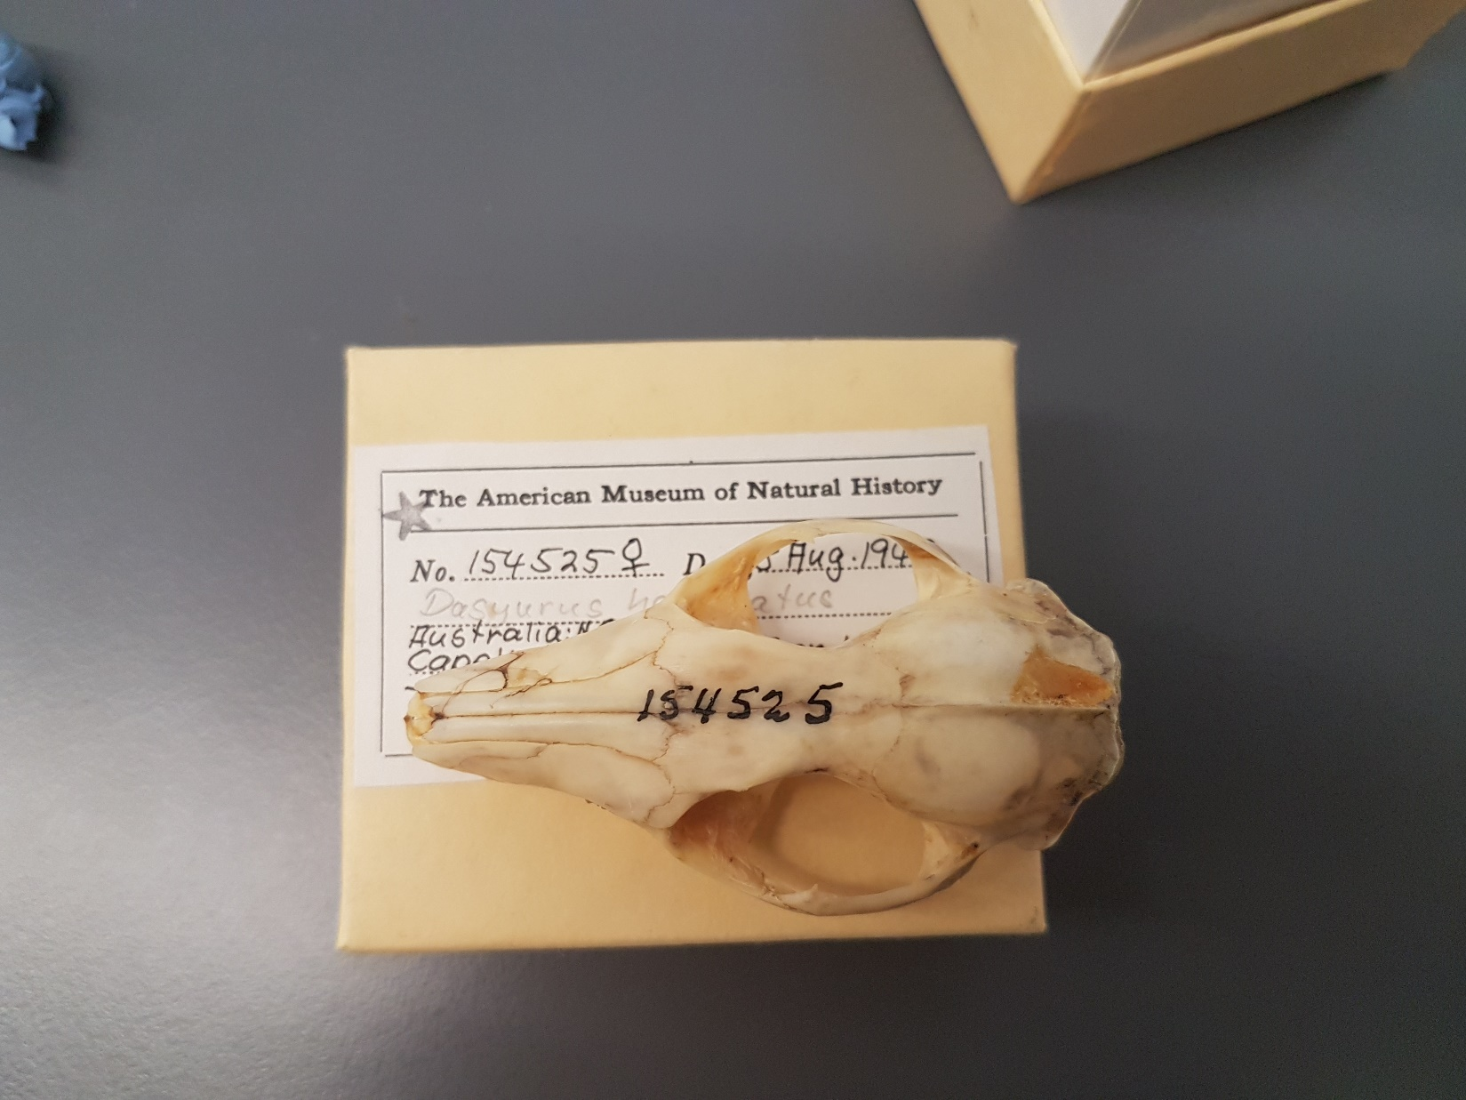
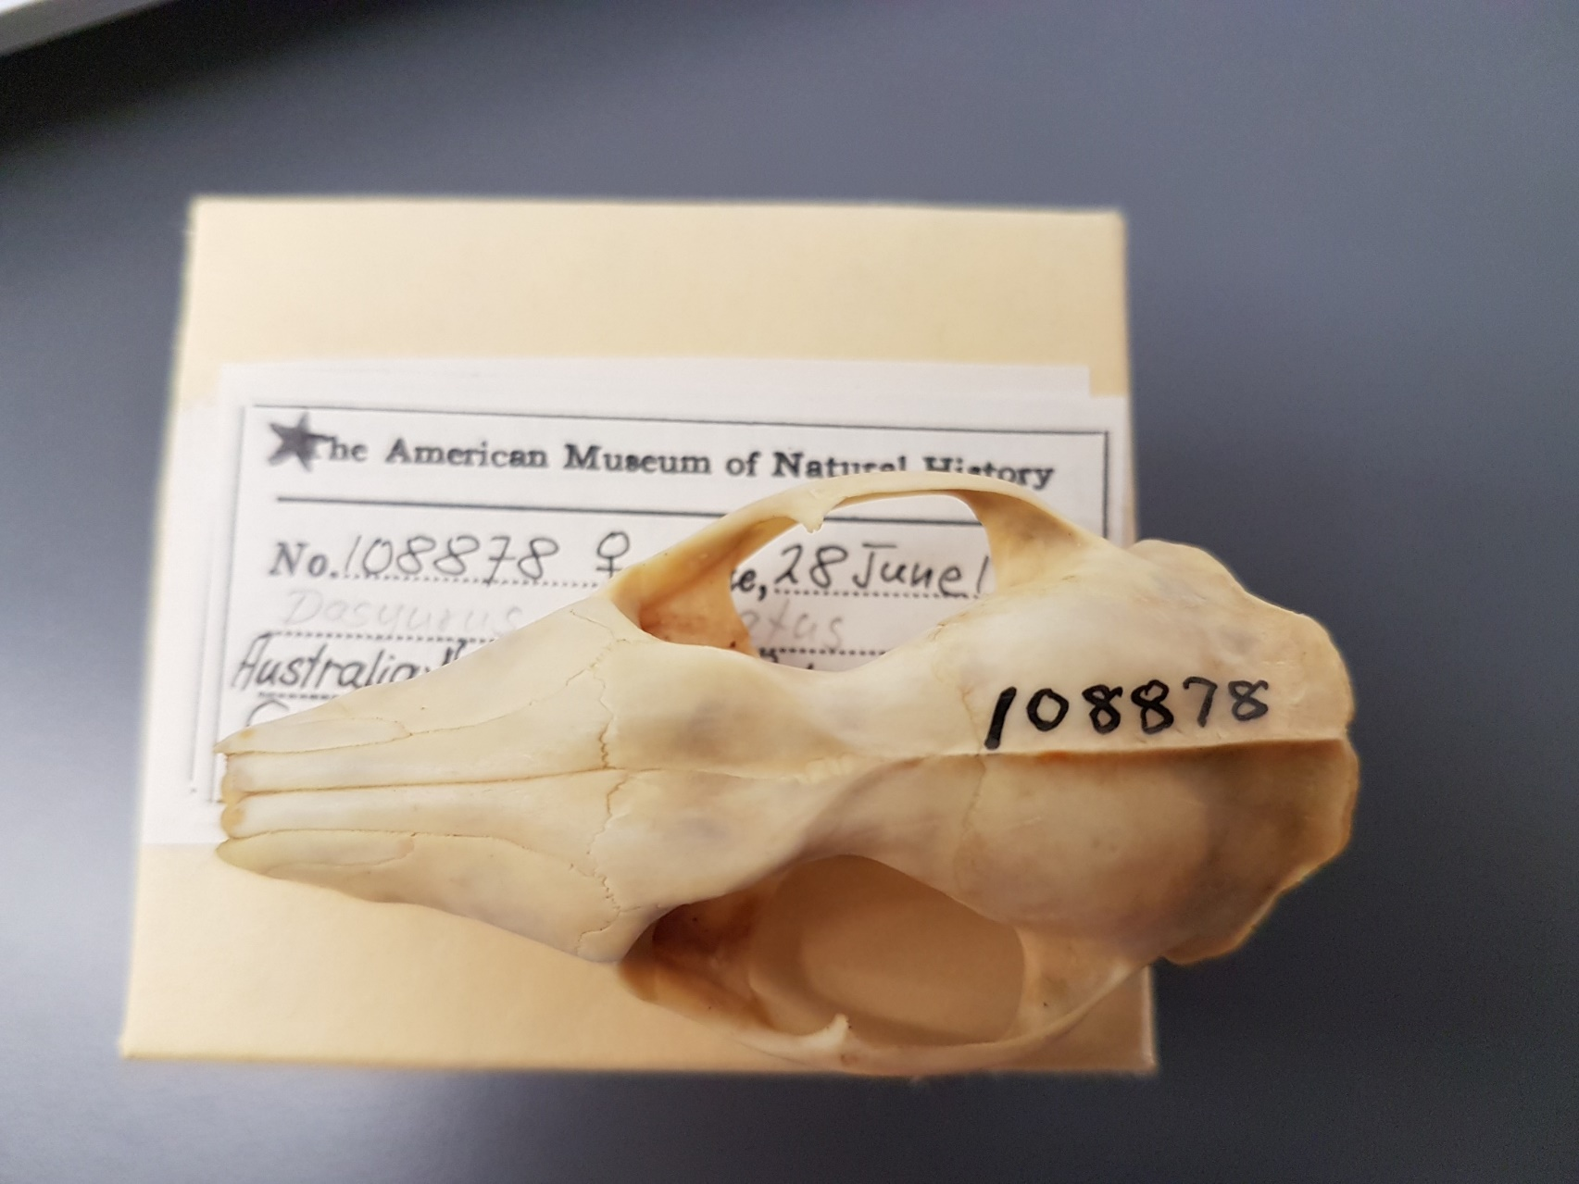

Slide 32
How do the linear and geometric morphometrics analyses perform in terms of discriminating groups of potential species and attributing individual group identities?
Extraction of linear measurements of 4 references (vandyck, Dickman, baker, travouillon) and one consensus (repeated linear measurements of vandyck, Dickman and baker). This extraction was done on the landmark coordinates obtained from 3D GMM.
Calculation of the geometric mean of the sample (GeoMean)
Calculation of shape ratio: log10(measurements/geometric mean) [some are negative values]
Subtraction of individuals with unidentified population. Extraction of individuals with known population identity.
We use these individuals with known population identity to perform Linear Discriminant Analysis, with equal prior to three clades and cross-validation
We use the resulting posterior values for the calculation of Uschi’s classification performance measures

Slide 33
GMM -> fitted residuals
Practice: Using PC1 to assess allometry
Problem: Allometry might be spread across more then 1 PC
Test for allometry in more than 1 PC
Test if PCs look different if allometr y free residuals are used (Mantel test to compare Scores in VEGAN).
Shape
Linear =
procD.lm? RRPP?
GMM = multivariate
Size
Linear = Log geometric mean
GMM = Log centroid size

